Slide 1
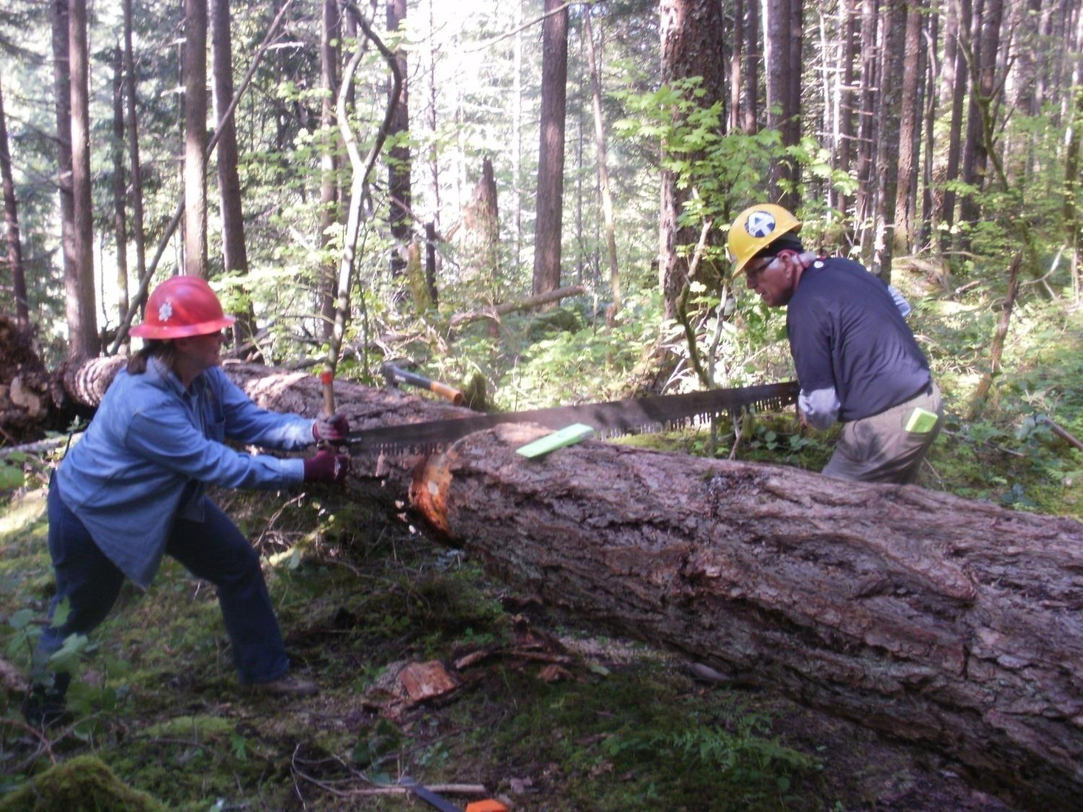
Notes:
Mt Hood Caretakers (Roberta and Bob) getting their re-cert 2011.

Slide 2
Saw Safety For Volunteer Sawyers
Bucking Only
March 2013
Notes:
Welcome – Introductions…introduce self (15 - 20 seconds is enough) … introduce other instructors and a brief point about them that establishes credibility. Have the students share who and where they come from. It is key not to let this take lots of time.

Slide 3
Course Overview
Saw Program
Safety Requirements
Situational Awareness
Case Study with Lessons Learned
Notes:
Go over these slow – then review them as needed at the end of the class. Let them know that this class is one of the requisites for certification and when that will be available for this group. Some students may be taking this as a preliminary to joining a skill development class and others may be taking this so they can get re-certified.
Have them write questions as you proceed through the material. Answer quick questions and address lengthy issues at the end during the review. Many of the questions are answered along the way and it is important to keep the class moving so folks don’t get tuned out.
Be firm with the individuals who want to question every detail. Let them know in blunt language that you will be entertaining questions at the end.

Slide 4
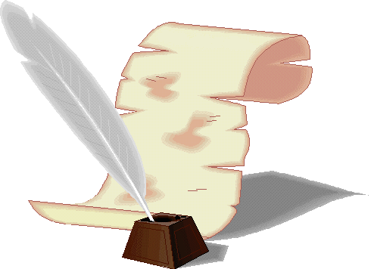
Memorandum of Understanding
2009 MOU page 13, item 1, PCTA shall:
“Provide chain and crosscut saw
operator safety training,
certification and recertification
opportunities using PCTA affiliated
instructor/certifiers and instructors
to meet the needs of the PCTA
volunteers and staff to the fullest
extent possible.”
Notes:
The PCTA and other volunteer programs (Back Country Horsemen of Washington) have an MOU agreement with the US Forest Service, Bureau of Land Management, National Park Service and California State Parks that supports them developing a self-certification program. This will hopefully result in each organization issuing its own certification cards.
Your cards for this event will be issued by the PCTA if you are an active member. If you are not a PCTA member, your card will be processed and issued by the local USFS Ranger District.

Slide 5
Sawyer Certification Levels
Trainee Saw Operator
1 year card
Must be supervised during all cutting projects
Saw Operator
2 year card
May work without supervision
Supervises Trainee Saw Operators
Volunteer Saw Instructor-in-Training
Assists in training events
Volunteer Saw Instructor (VSI)
Trains and evaluate Trainee and Saw Operators
Notes:
We have eliminated the size restrictions that have been traditionally associated with each level. We are now emphasizing the evaluation of complexity and the rigorous use of the Go – NO GO analysis.
It is central to this new card-designation standard that it be fully understood that a B sawyer is charged with the responsibility of self regulation, saw-crew-leadership, and project safety. Every B sawyer can supervise an A sawyer. On every crew, a saw lead needs to be designated so there is no question which B sawyer is in charge. B sawyers will often supervise other B sawyers.
It is the responsibility of the lead sawyer to identify, flag, and inform the land manager of those logs that need a higher skill level sawyer.
Discuss how the VSI training is being done in your area.
ALL instructor/evaluators must be C-Certified by the USFS.

Slide 6
Saw Crew Leader
Each saw crew needs a lead sawyer
Determined prior to project
Responsible for:
correct equipment
confirm with crew leader that the EAP and TCP are completed
assigning work to swampers
There may be 2 or 3 saw crews, each with a saw crew leader, who all work under the organization of the trail crew leader
Trail crew leader responsible for JHA, TCP and EAP
Notes:
Who is the leader? Let’s hope it isn’t this guy. Each saw crew needs a lead sawyer and that Must be determined prior to beginning the project. That will be the person responsible for getting the correct equipment, confirming that the emergency and communication plans are in place, and making field work assignments.
Only 1 Leader on a saw crew!
There may be 2 or 3 saw crews (each with a leader) who all work under the organization of the event crewleader.
The event leader will often facilitate the JHA and create the Comm. & Emer. Plans, but the saw crew leader is singularly responsible for the work plan and safety.
Saw Crew Leader vs Crew Leader
Often trail crew leader and saw crew leader are one in the same but not always.

Slide 7
Safety Requirements Saw crew leaders must be sure that all of the following are covered before beginning a project:
PPE
First Aid & CPR
JHAs
Trailhead Communication Plan
Emergency Action Plan
Notes:
Ask what other items need to be in place before the crew leaves the trailhead

Slide 8
Personal Protective Equipment (PPE) Crosscut (All equipment must meet USFS standards)
Hard Hat Full brim or cap style
Eye Protection Safety glasses or shield when chopping
Hearing Protection Not Required
Long-sleeve Shirt Recommended
Gloves Slip-resistant, appropriate for the weather conditions
Trousers Loose fitting
Boots Heavy-duty, cut resistant or leather, laced,
with nonskid soles and adequate ankle support
First Aid OHSA-compliant kit, one with each saw crew

Slide 9
Personal Protective Equipment (PPE) Chain saw (All equipment must meet USFS standards)
Hard Hat Full brim or cap style
Eye Protection Safety glasses, goggles or shield
Hearing Protection Plugs or muffs
Long-sleeve Shirt Required at all times
Gloves Slip-resistant, appropriate for the weather conditions
Trousers Loose fitting
Boots Heavy-duty, cut resistant or leather, 8 inch-high, laced, with nonskid soles and adequate ankle support
First Aid OHSA-compliant kit, one with each saw crew
Notes:
Don’t spend too much time on each item as this is covered in detail in the introductory classes. If your class is not supported by a Trail Skills event and your students are new to the PCTA Program, then do cover them in detail.

Slide 10
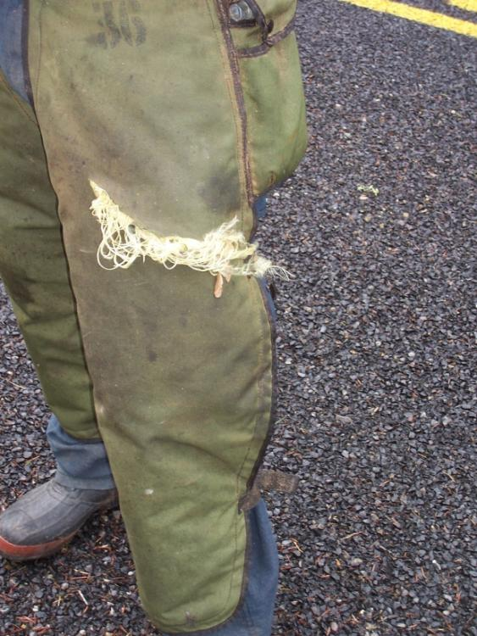
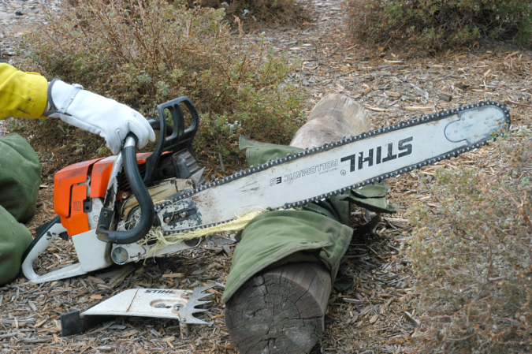
Chain Saw Chaps
Must overlap boots at least 2 inches
Use only clean saw chaps (uncut and undamaged by oils and solvents)
They must meet the current USFS or ASTM specifications
Notes:
Discuss how Kevlar binds up the chain and clutch.

Slide 11
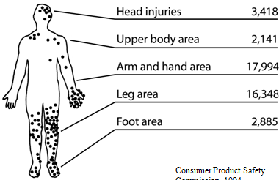
Chain Saw Injury Location & Frequency
Consumer Product Safety
Commission, 1994
Notes:
This demonstrates why we are required to wear the PPE.
David to add overlay of PPE
More than 40,000 people are injured by chain saws each year.
The two most common places for injuries are the front left thigh and the back of the left hand.
The average chain saw injury required 110 stitches and cost $5,600 in 1989. The safety equipment costs less than $100.
Total cost of all injuries was estimated at $350 million.
This does not include losses of productivity or quality of life.
When a chain saw is at full speed, more than 600 teeth pass a given point per second.
One in 5 chain saw injuries are from kickback.
A muffler on a chain saw can reach as much as 900 degrees F.
A chain saw chain can move up to 68 miles per hour.

Slide 12
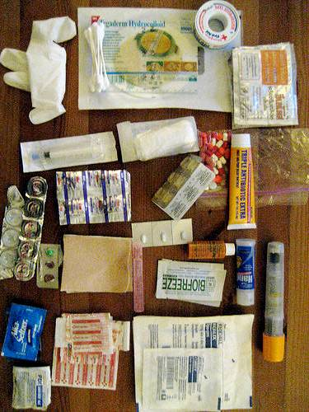
First Aid Kit
OHSA-compliant
Two large gauze pads (at least 8 x 10 inches)
Two elastic wraps
PCTA Injury Info Packet
Notes:
PCTA Volunteer Injury Info Packet Contents:
Volunteer injury instructions
SOAP note forms
Federal CA-1 Report of Injury
PCTA Witness Statement form
Extra TCPs & EAPs
The following list sets forth the minimally acceptable number and type of first-aid supplies for first-aid kits required under paragraph (d)(2) of the logging standard. The contents of the first-aid kit listed should be adequate for small work sites, consisting of approximately two to three employees. When larger operations or multiple operations are being conducted at the same location, additional first-aid kits should be provided at the work site or additional quantities of supplies should be included in the first-aid kits:
1. Gauze pads (at least 4 x 4 inches).
2. Two large gauze pads (at least 8 x 10 inches). INSTRUCTORS – This item is not standard in first aid kits.
3. Box adhesive bandages (band-aids).
4. One package gauze roller bandage at least 2 inches wide.
5. Two triangular bandages.
6. Wound cleaning agent such as sealed moistened towelettes.
7. Scissors.
8. At least one blanket.
9. Tweezers.
10. Adhesive tape.
11. Latex gloves.
12. Resuscitation equipment such as resuscitation bag, airway, or pocket mask.
13. Two elastic wraps.
14. Splint.
15. Directions for requesting emergency assistance.

Slide 13
Job Hazard Analysis (JHA)
www.pcta.org/volunteer/crew-leader-center/#planning
Scroll down to “Job Hazard Analysis (JHA)”
May need one or more JHA
Check with your PCTA Regional Rep to confirm version
Review and highlight the main points
Note weather and other special conditions
Everyone must sign the back page
Mail with the PCTA Project Report to Sacramento
Notes:
Have you done everything you can to mitigate the hazards of the project? This isn’t just another form to process!
It needs to be pointed out that this is a critical form with original signatures that will provide credibility to your insurance claim in the event of a mishap. You are covered by the USFS workmen’s comp policy if you are following their policies.
It is advisable for the Crew Leader to review this form and highlight the applicable items prior to the event.
May need one or more JHA: Trail Maintenance - Saw Use – Livestock/Packing - Rigging

Slide 14
Safety Requirements Review
PPE
First Aid & CPR
JHAs
Trailhead Communication Plan
Emergency Action Plan
Notes:
People probably have been shuffling papers and you want to be sure to wrap up any questions, make sure everyone feels like they have copies of what they want, directions on how to get the docs off the website, etc.

Slide 15
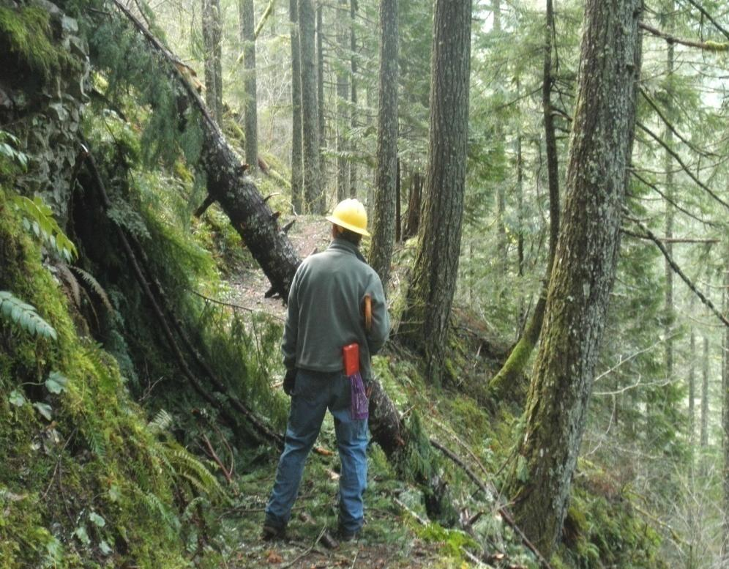
Situational Awareness

Slide 16
Environmental Conditions
Wind: Pinecones and small branches falling
Ice: NO GO on sloped work-site
Rain: Is it too slippery?
Heat: Will heat prevent completion of project?
Light: Is there enough light to finish the project and clean up?
Constantly reassess throughout the day
Notes:
The point here is that no project is worth putting volunteers at risk. Be sure to consider the distance to help when preparing for the project.
Constantly reassess throughout the day.
15 mph guideline
David – Add text for example from November of high wind

Slide 17
Notes:
Hand out the explanation sheet and discuss it in detail for new students.
If a sawyer sees something that they think is not safe…ask questions. Help each other remember to have ALL PPE in place when sawing.

Slide 19
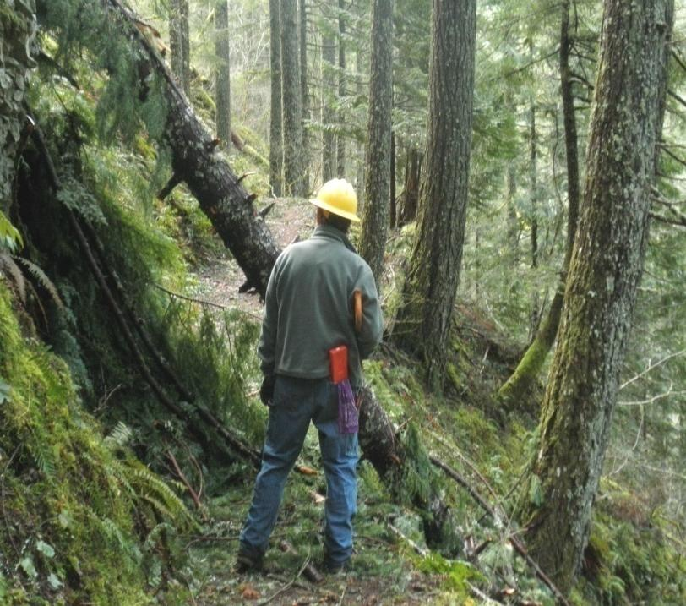
Situational Hazard Awareness
Environmental conditions
Overhead survey
Ground survey
Site prep
Crew and equipment
Cut analysis and plan
Notes:
The sawyer needs to be constantly reviewing the surrounding environment and looking for potential hazards. The projects will make themselves obvious.

Slide 20
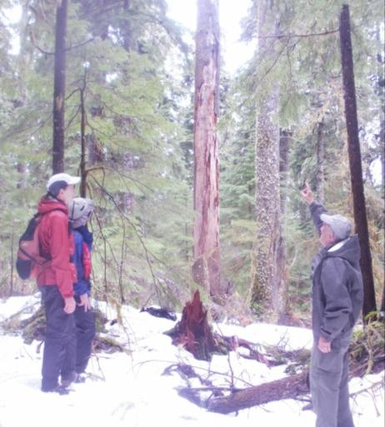
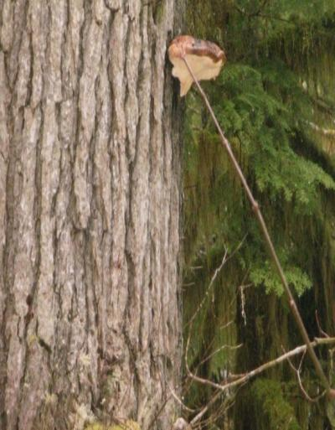
Overhead Hazard Survey
Look at all the standing timber to determine its condition
Check for:
Snags
Leaners
Loose Limbs
Loose Bark
Feeding Holes
Insect Activity
Conks and Mushrooms
Shelf or Bracket Fungi
Sap Rot
Can the wind or your work cause these hazards to fall and harm you, your crew, hikers or equestrians?
Notes:
Have the students list the things to look for before you put them on the screen.

Slide 21
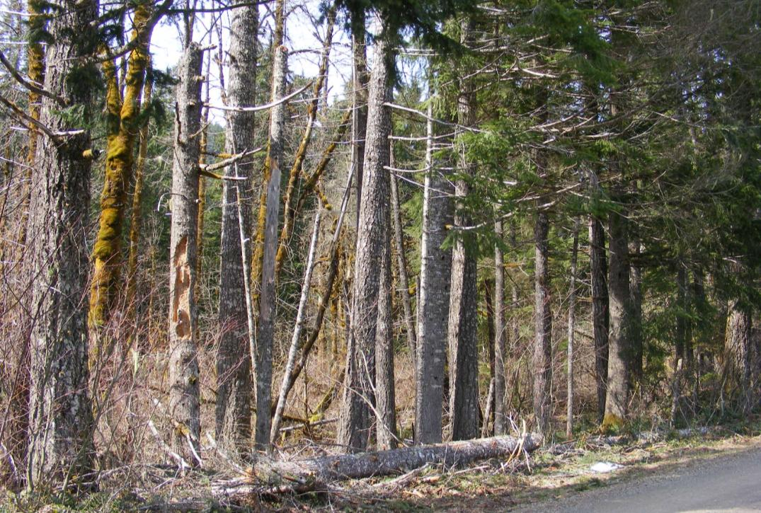
Hazards: Snags
Notes:
If you role a log against the bottom of these snags, the top will likely snap off and come toward you.

Slide 22
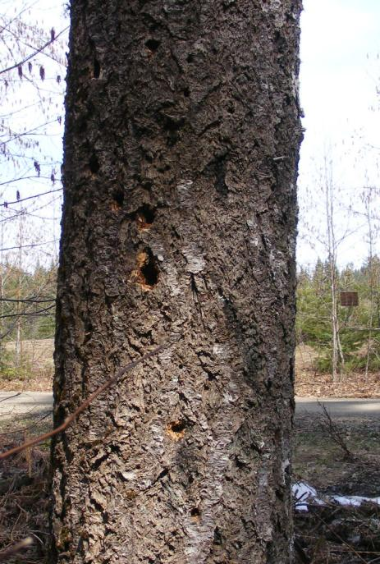
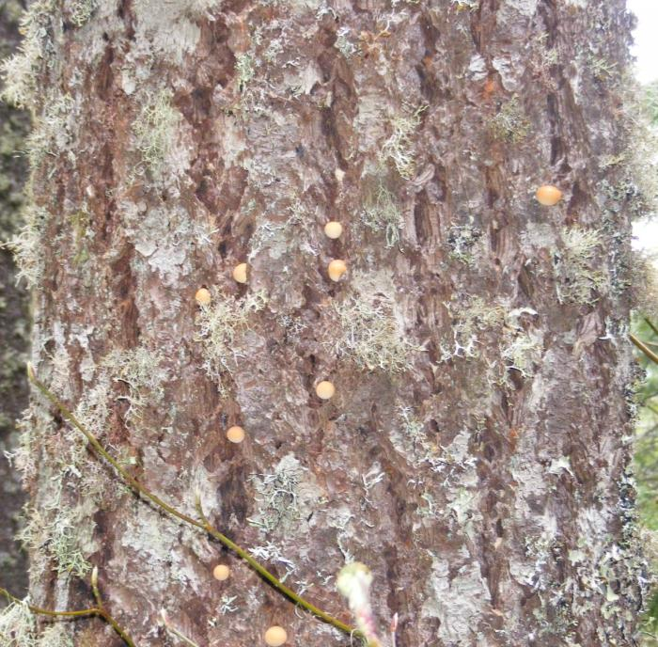
Hazards: Sap Rot Indicators
Notes:
Sap rot conks are another indicator & sap root feeding hole
Sap rot is not tree disease, it is part of the natural decomposition process after the tree dies. Feeding holes are one indicator

Slide 23
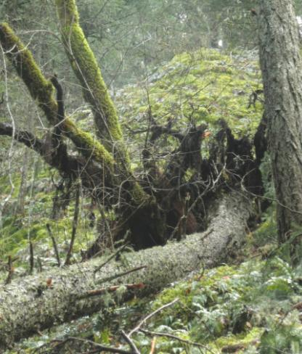
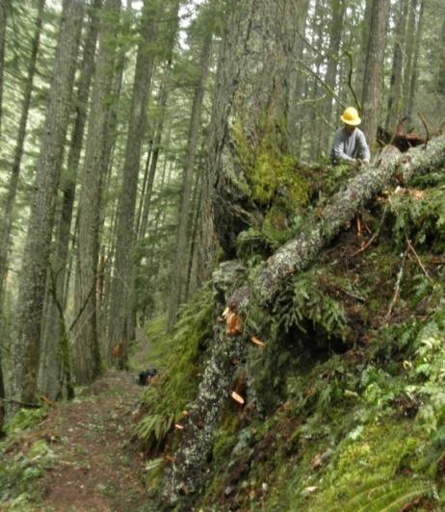
Ground Hazard Survey
Walk the length of the log
Look for:
Spring poles
Bearing points
Pivot points
Rootwad
Up slope
Down slope
Both sides
Foreign objects on or under log
Notes:
These are the key issues that are often rushed through. Take the time to go over each one. Have each student talk about one of the items listed.
Top photo shows how important it was to hike up the steep slope and see the root-wad securely hooked around a 16” live maple tree. It also informed the sawyer that the tree fell from the cliff above, slid to its location , and was a healthy tree without root rot that might effect the cut.
Bottom photo shows a secure cutting point (a rock shelf ) for the sawyer to work on. Spotters visible to the sawyer, both up and down trail, keep hikers out of the work zone.

Slide 24
Hazards: Spring Poles

Slide 25
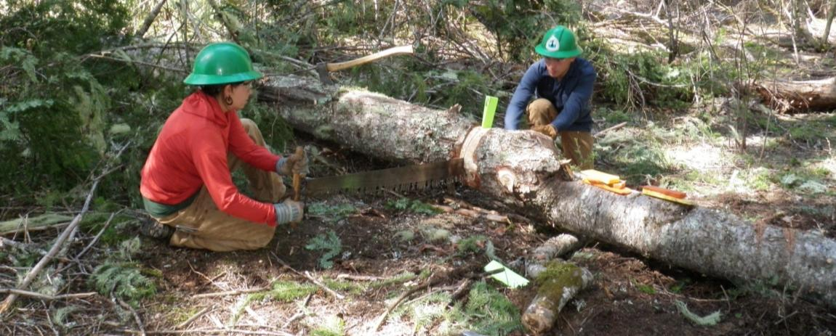
Site Preparation
Remove branches
Remove debris from tread
Remove spring poles
Remove bark (crosscut)
Prep bucking location
Support aids, if needed
Notes:
This green fir was full of branches and fell into an understory of vine maple and huckleberry. These AmeriCorps crew-members demonstrate a great job of preparing the site before they began the sawing. Note that there is no obstruction to the saw motion and they both have an escape if the log moved during the release.
Also note that there is a small log under the tree. During the clearing process, they found material to slide in under the work and lift it off the ground. They used a series of wedges and blocks of wood to lift the log.
Support aids include sleds, skids, cribbing

Slide 26
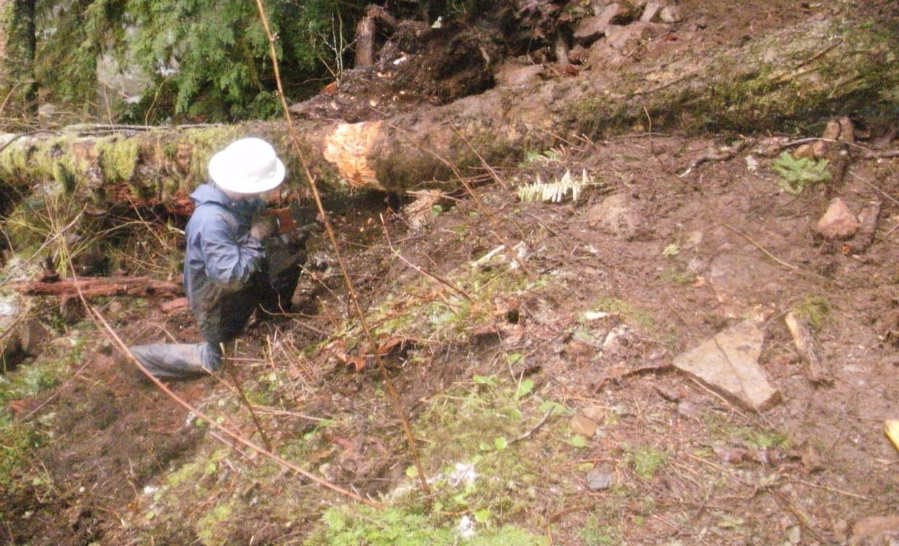
Site Preparation
Notes:
Sometime the sawyer needs to build a full-bench area to work on.

Slide 27
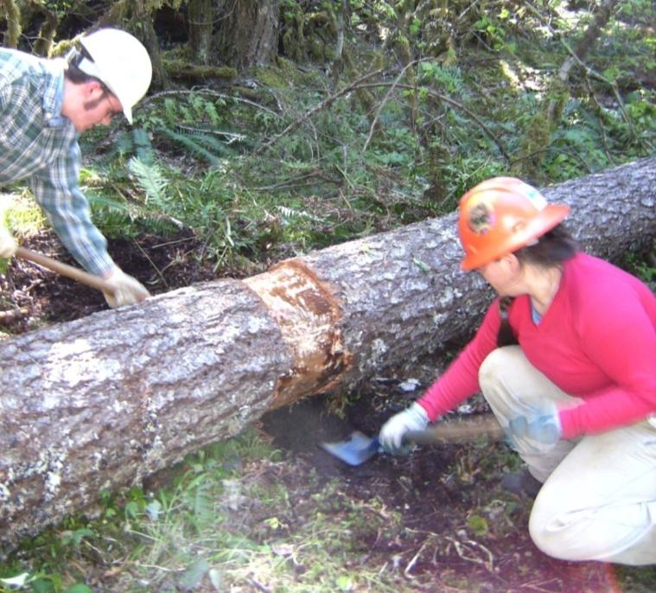
Site Preparation
Notes:
Have the students come up with reasons to clear out and even dig under a log at the cut point.

Slide 28
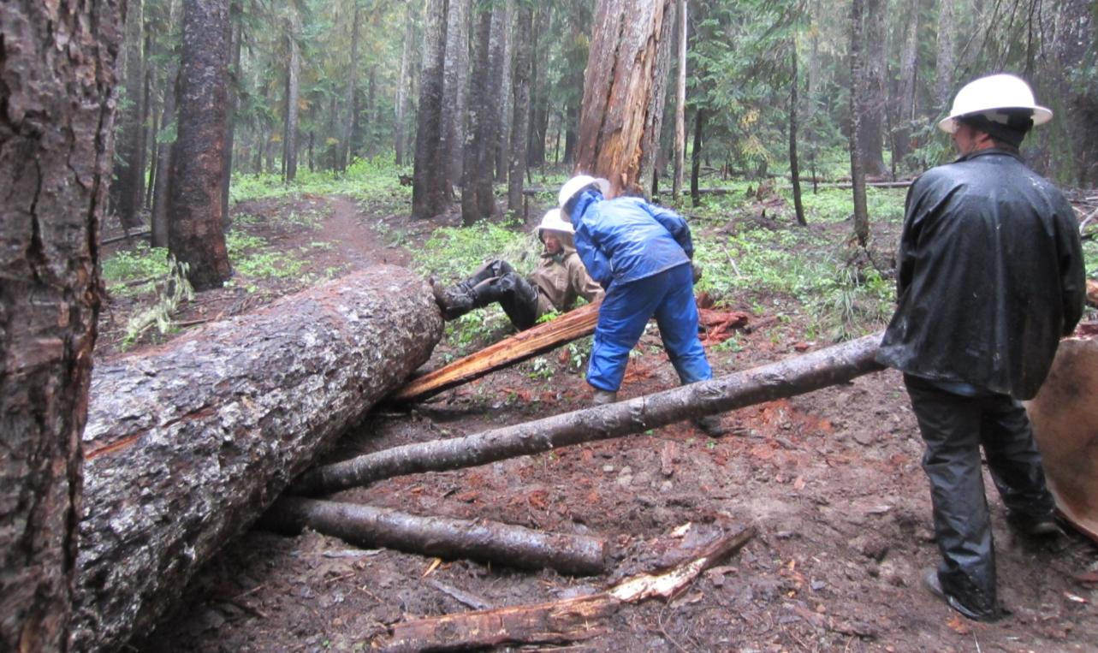
Site Preparation - Support Aids
Notes:
By using a lever you creat a mechanical advantage

Slide 29
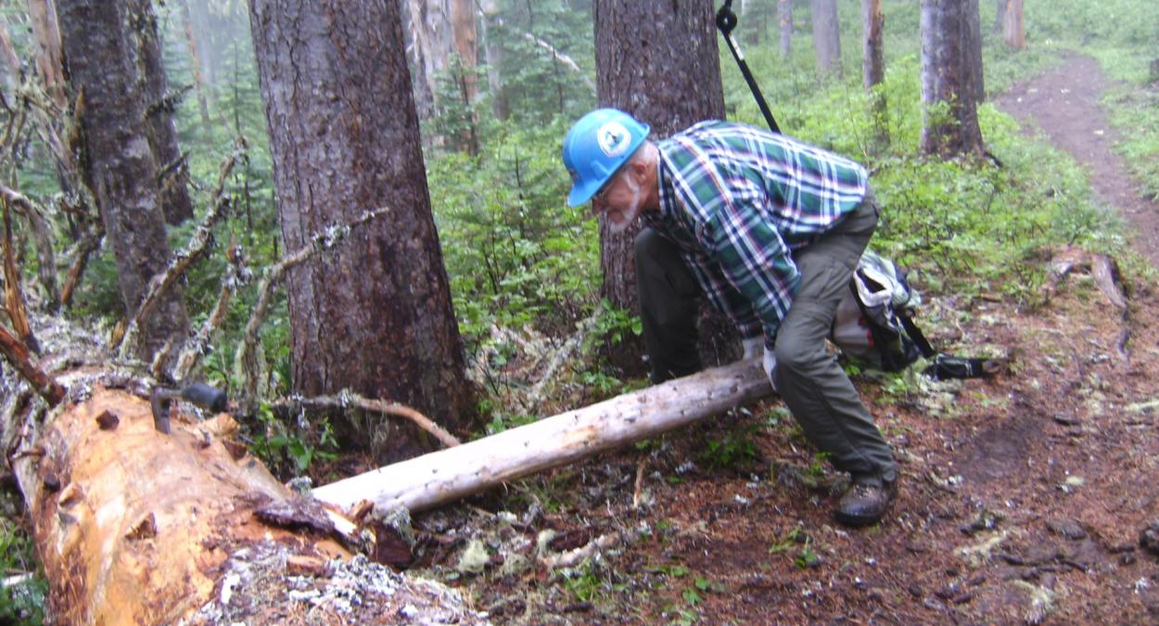
Site Preparation - Support Aids
Notes:
By using a lever you creat a mechanical advantage

Slide 30
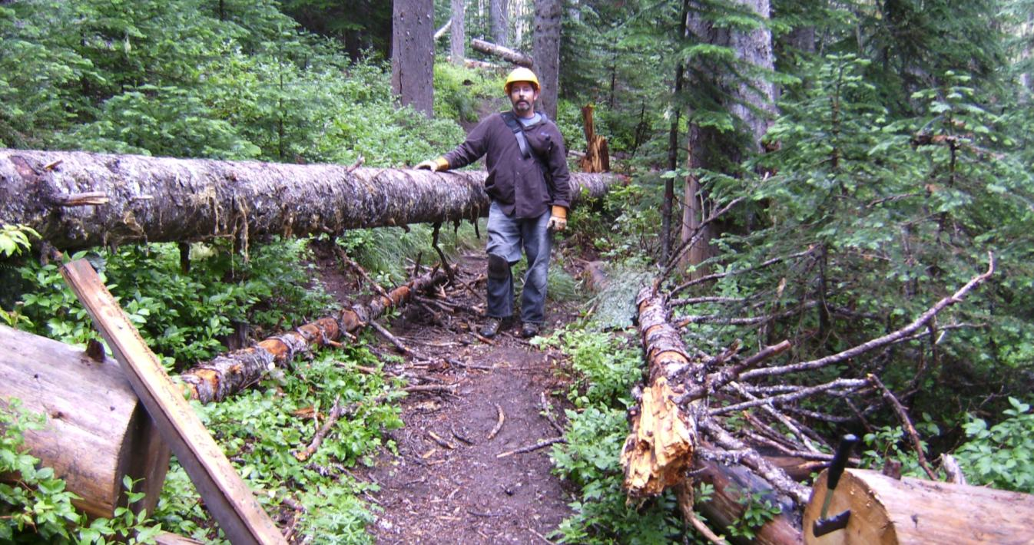
Site Preparation - Support Aids
Notes:
This log would require 6 of 7 cuts to clear the trail or…

Slide 31
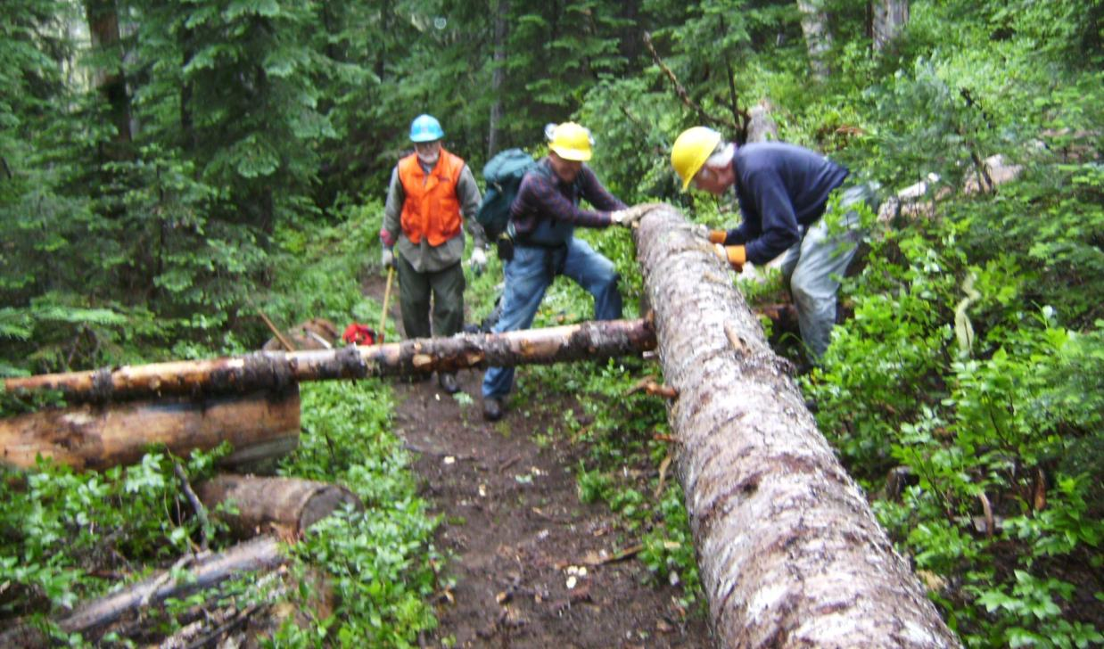
Site Preparation - Support Aids
Notes:
Create skids that will carry the whole log right over the obstacles on the ground.

Slide 32
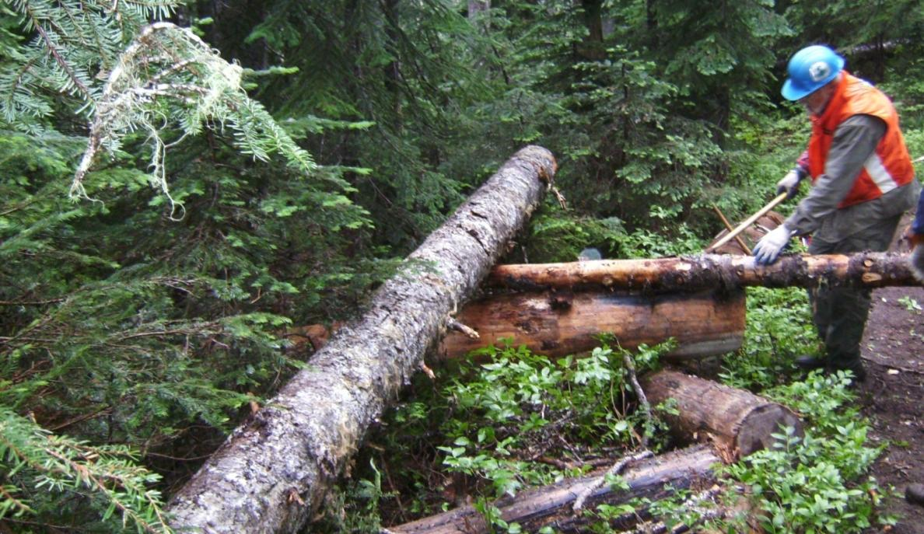
Site Preparation - Support Aids
Notes:
Cleared trail with just 2 cuts by adding skid logs.

Slide 33
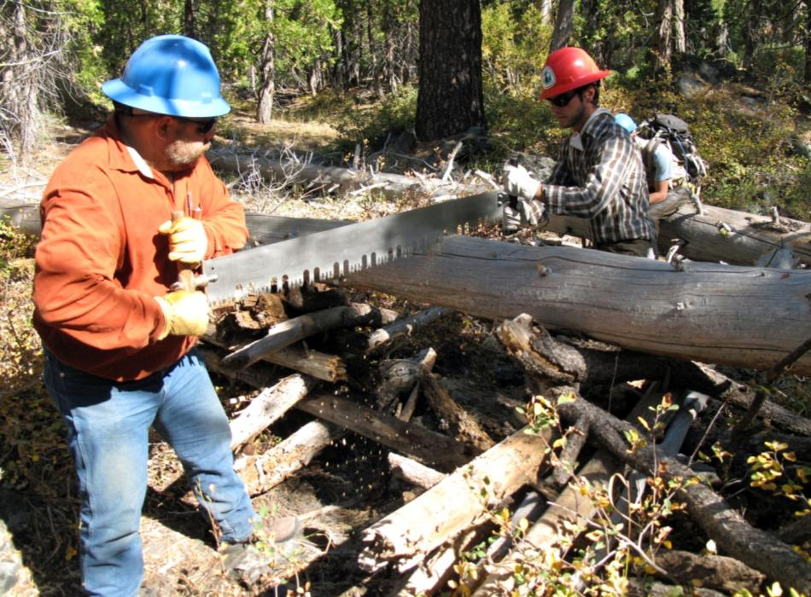
Site Preparation - Support Aids
Notes:
Build cribbing to catch the dropping log.

Slide 34
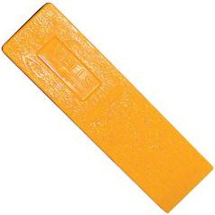
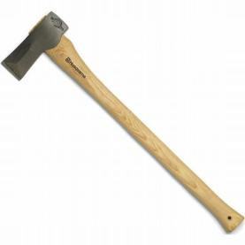
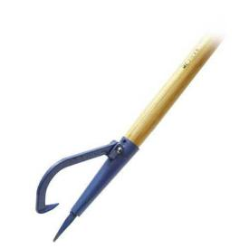
Crew & Equipment Considerations
Do you have the right crew for the job?
Do you have the proper safety equipment?
Do you have enough gear? The right gear?
Do you have enough people to keep trail users clear of the work area?
Don’t Start a Project Without the Right Stuff!
Notes:
Give an example of each that is pertinent to the students and region.

Slide 35
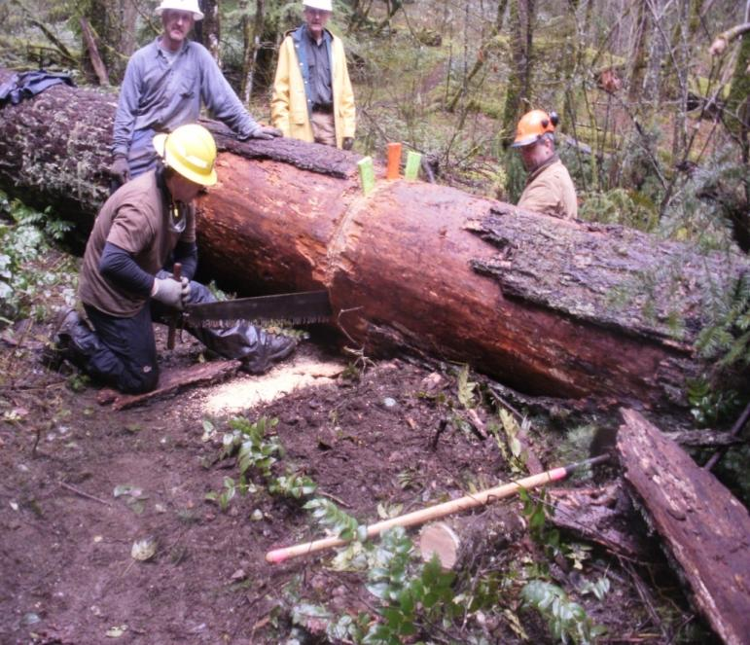
Cut Analysis & Plan
Bind Evaluation and Mitigation
Action Plan
Site preparation
Crew assignments
Crew communication
Cut sequence
Cut piece track
Cut design
Escape routes
Notes:
Discuss all these items before the cut. Create a team effort and on big ones trade off regularly.
Not seen in the photo are two 8” maple poles that were used as skids to move this half-ton out-cut. Always look for local materials to help make the work easier. The skids saved this crew 2 cuts of this 44” log.
Ask the students to list the types of binds

Slide 36
Before the Saw Touches the Wood...
Notes:
It may seem a bit redundant, but this helps the students begin to get in a habit of checking.

Slide 37
Situational Hazard Awareness
Environmental conditions
Overhead survey
Ground survey
Site prep
Crew and equipment
Cut analysis and plan
Notes:
The sawyer needs to be constantly reviewing the surrounding environment and looking for potential hazards. The projects will make themselves obvious.

Slide 38
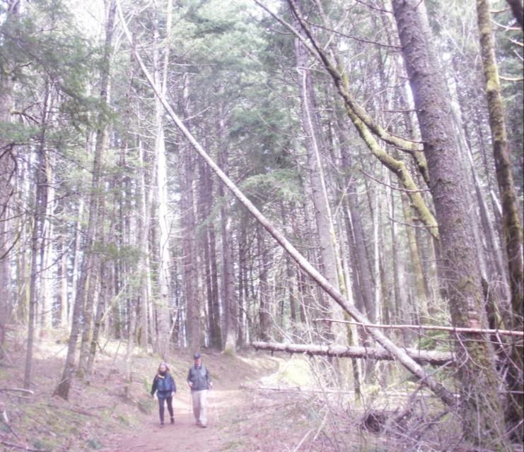
Bucking Only
Insert photo of leaner
Which one of these would you or should you cut?
Notes:
This is a trick question…the leaner is the obvious answer. The other one is too high unless you go way off tread and it has already been cut back enough for this equestrian trail.
Instructor: Discuss the difference between bucking and felling.

Slide 39
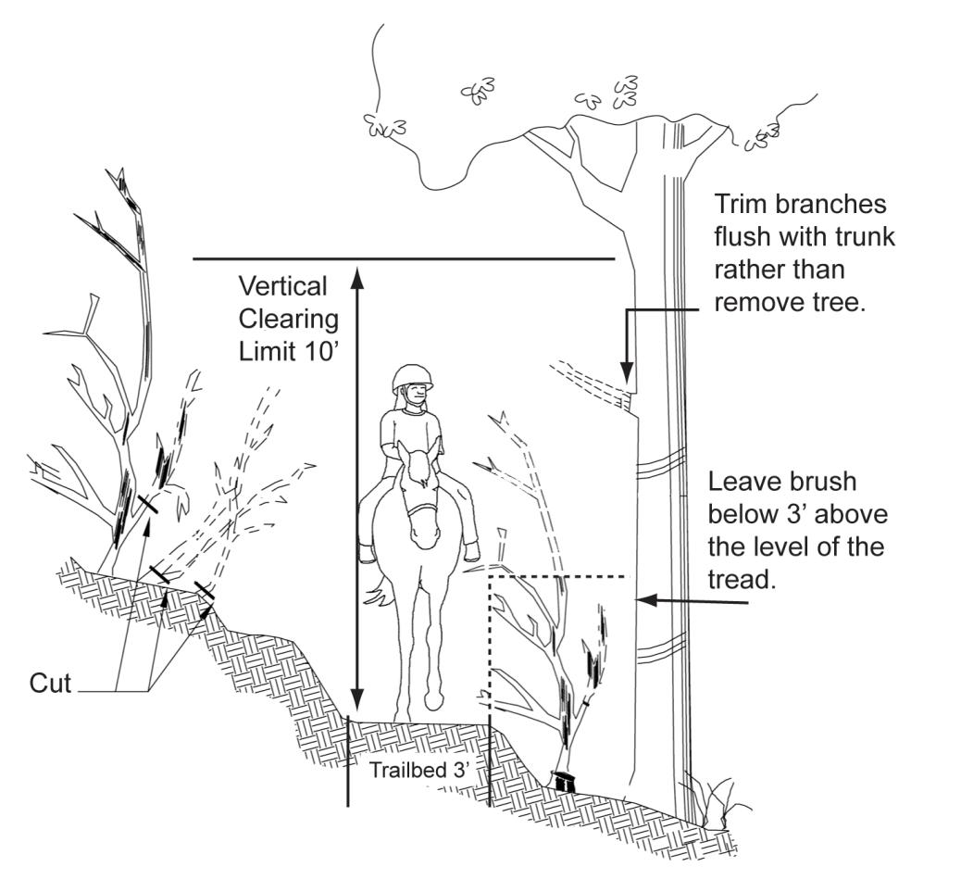
Where to Cut
Notes:
Before leaving the Cuts, there needs to be a discussion regarding trail width:
4’ below the knee
10’ wide up to 10’ high
In some wilderness areas the land manager wants it 3’ with obvious straight cuts at trail edge to better mark the trail in the winter.
Highly dependent on agency and unit specifications – always ask.

Slide 40
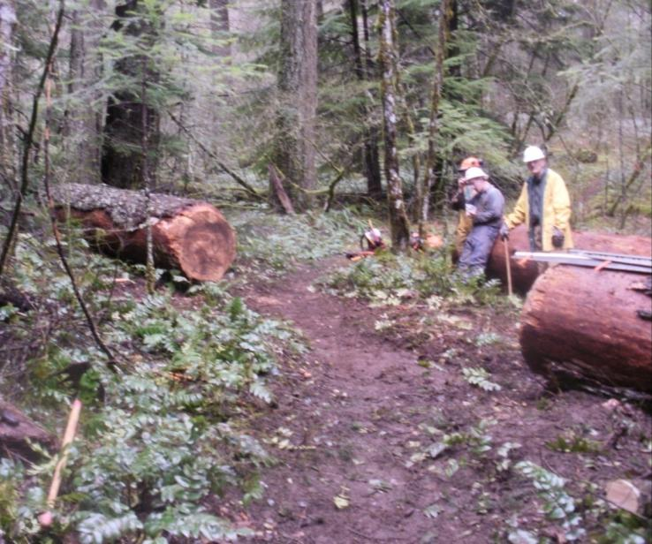
Leaving the Project Site
Is everything secure?
Do you have all tools?
Is the tread restored?
Is the setting restored?
If there is any dangerous condition that you are unable to correct…
Notes:
The out-cut of this log was more than 1000 pounds. It is critical that it be secured so it won't roll if kids play on it.
On larger projects that require lots of tools, it is easy to loose small items … count them before and after.
Don’t just be a sawyer…our mission is trail maintenance. Take appropriate gear to restore the tread after you clear the logs.

Slide 41
If it is a hazard to normal hiker or equestrian safety… Flag It!
Inform Land Manager As Soon As Possible
Note location
Condition details
Equipment needed
Forest condition
Landscape conditions
Notes:
Take flagging tape and demonstrate how to flag a hazard. Don’t hang 12” on the limb or a single wrap on a snag. Make it look like a crime-scene if it is truly a hazard.
You need to be clear about the hazard…. You are imposing a required action on the land manager by identifying the hazard; for example a leaner is normally not a hazard and just needs to be noted in the project report.

Slide 42
Hazard Tree Study
Warm Springs Indian Reservation
July 2012

Slide 43
Scenario
High winds caused two trees to uproot and fall across the PCT.
On their way down, they collided with the crown of a third tree, just a few feet from the trail, causing its trunk to shatter vertically and the tree to lean over the trail.
The third tree did not fall because its crown became entangled in the crowns of two trees on the other side of the trail.

Slide 44
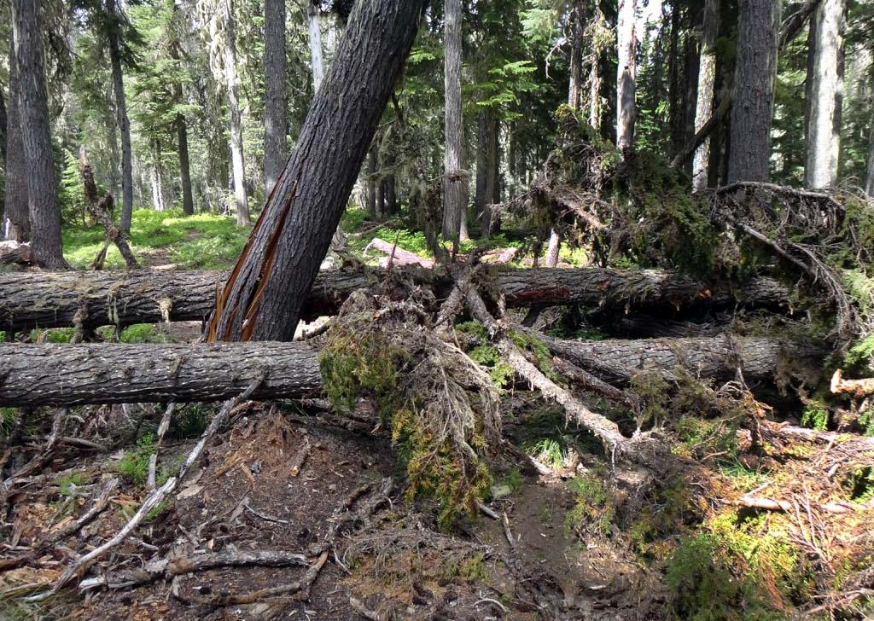
Proximity of Trees to Trail
Trail
(facing north)

Slide 45
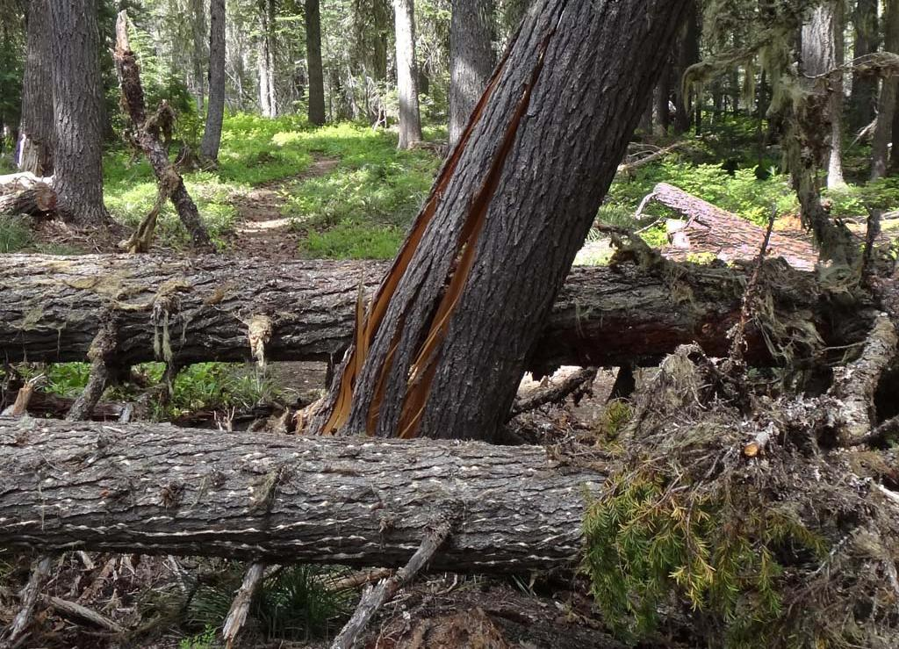
Condition of Leaner
You can see right
through the trunk!

Slide 46
Side Bind
Because the northernmost blowdown was wedged between the leaner and a sound tree on the other side of the trail, it developed a severe side bind.
This tree had approximately 6 feet of horizontal bend over a distance of 50 feet.

Slide 47
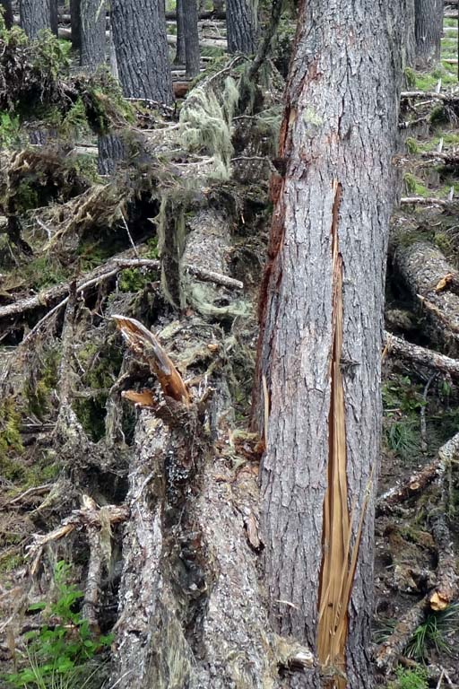
Side Bind
Fulcrum
Tension
Offside
Fulcrum

Slide 48
Go or No-Go?
Using established Go/No-Go criteria, the initial volunteer saw crew decided this situation was beyond their capability.
The crew clearly marked the hazard area and reported the situation to the USFS, the agency managing this section of the PCT.

Slide 49
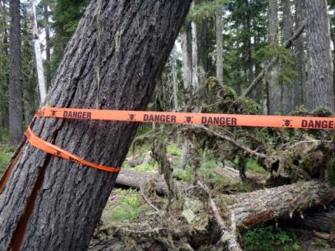
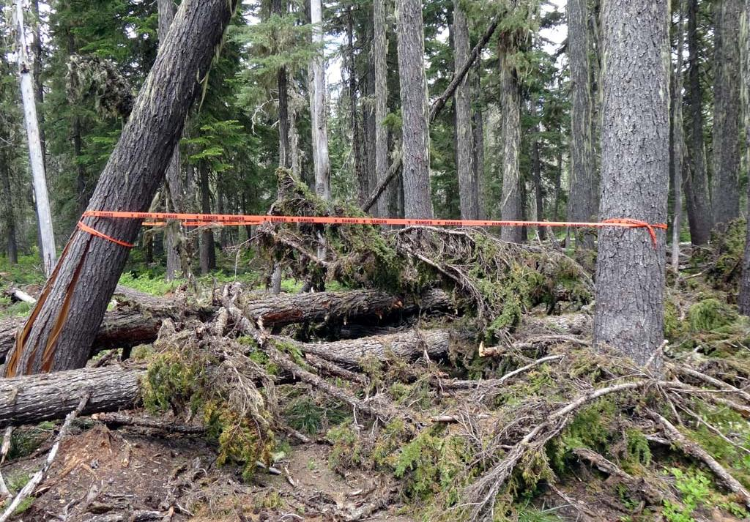
Marked Hazard Area

Slide 50
Two Weeks Later…
A second crew of volunteers plus a USFS recreation manager returned to site.
Decision was made to temporarily reroute trail 15 feet west to avoid leaner.
Area was cleaned up. Log with side bind severed (with 3 feet of springback). All logs bucked, opening temporary bypass.
Long-term plan: return trail to original route after subsequent winter winds take down leaner.

Slide 51
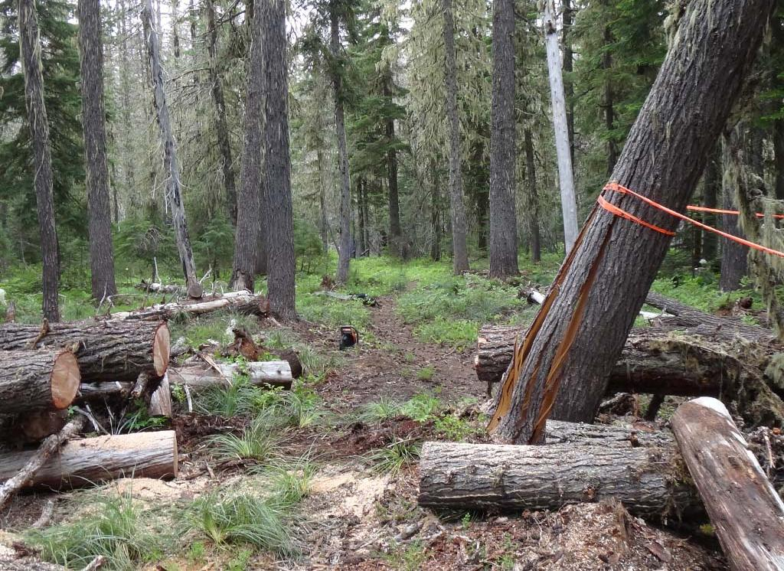
Reroute

Slide 52
Case Study Lessons Learned
Summary of relevant known incidents and accidents

Slide 53
Course Review
Saw Program
Safety Requirements
Situational Awareness
Case Study with Lessons Learned
Notes:
Give the students time to go back through their notes and ask questions.

Slide 54
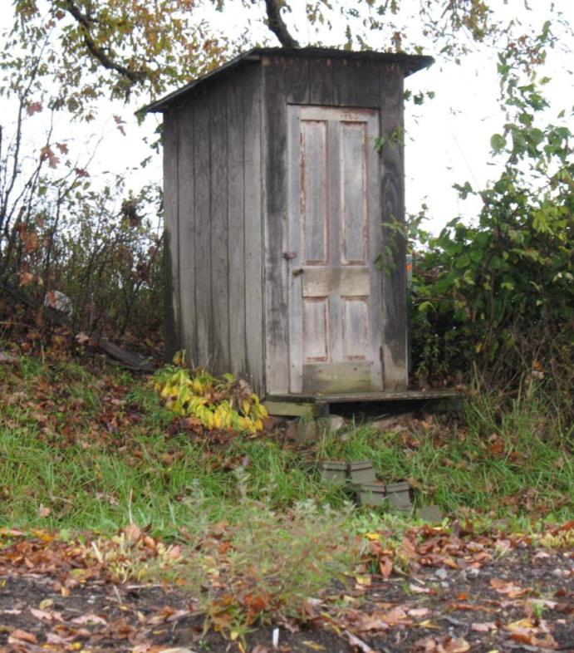
Break Time
Picture of an Outhouse

Slide 55
Bind Analysis & Cut Sequence
For Trainee Saw Operators and Saw Operators
March 2013

Slide 56
Course Overview
Types of Binds
Types of Cuts
General Considerations

Slide 57
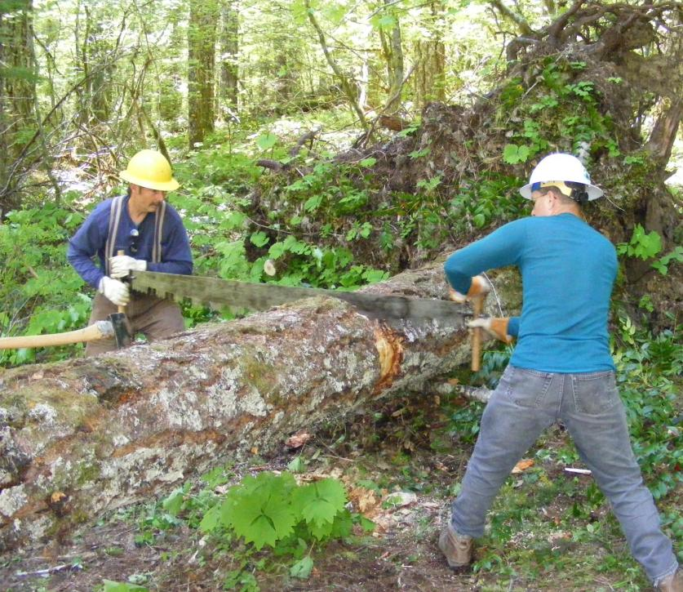
Types of Binds
Top bind
Bottom bind
Side bind
End bind
Complex bind

Slide 58
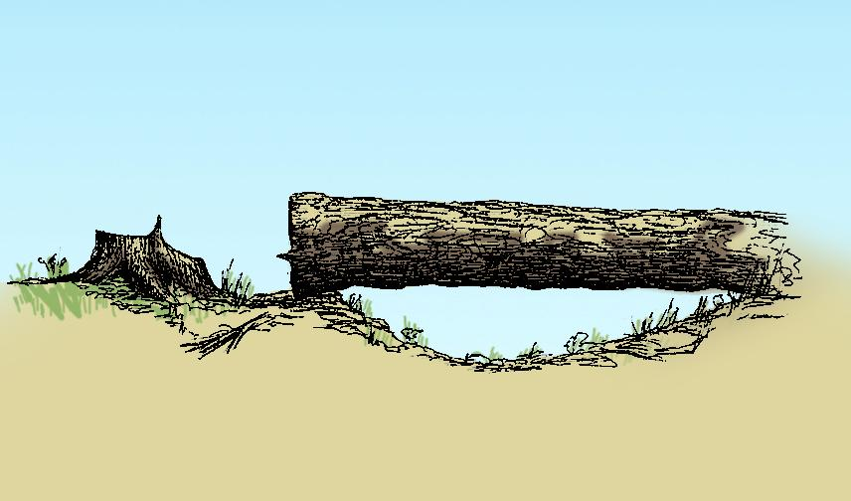
Top Bind
compression
tension

Slide 59
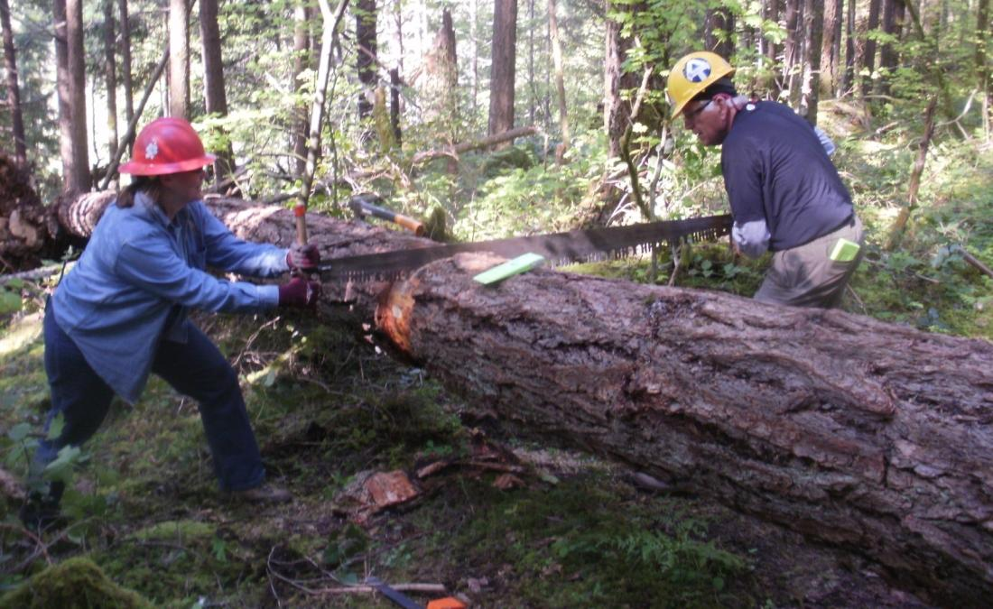
Top Bind
Notes:
Cut as deep as you can. If you get in deep enough to wedge above (10” plus diameter log) you may not need to underbuck. On smaller logs underbucking will normally be required. However, smaller logs can be lifted to change the bind with a lever or wedges when near the ground.
Note:
A small undercut is useful to help with a clean release. The cambium layer is very tough and will hold the log together.

Slide 60
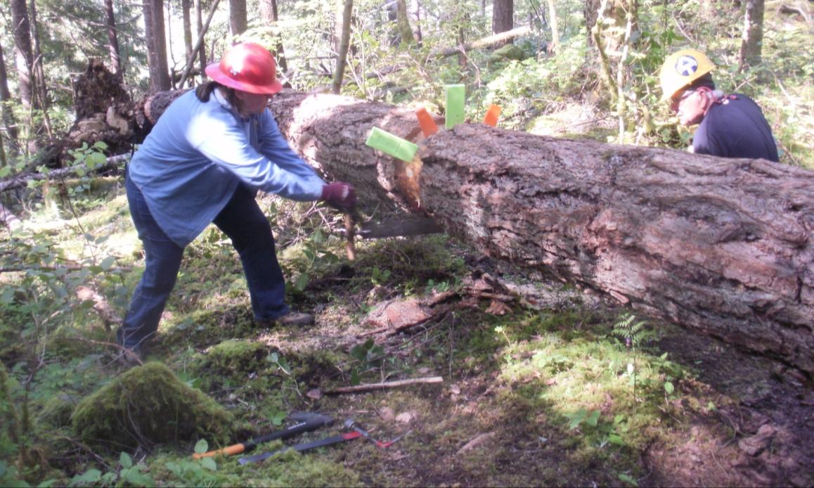
Top Bind
Notes:
If the log is deep enough, use a second set of wedges.

Slide 61
Top Bind

Slide 62
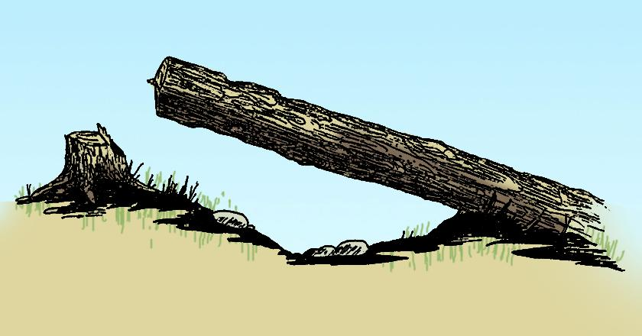
Bottom Bind
tension
compression
Underbuck – Then top cut – Be ready for lots of action

Slide 63
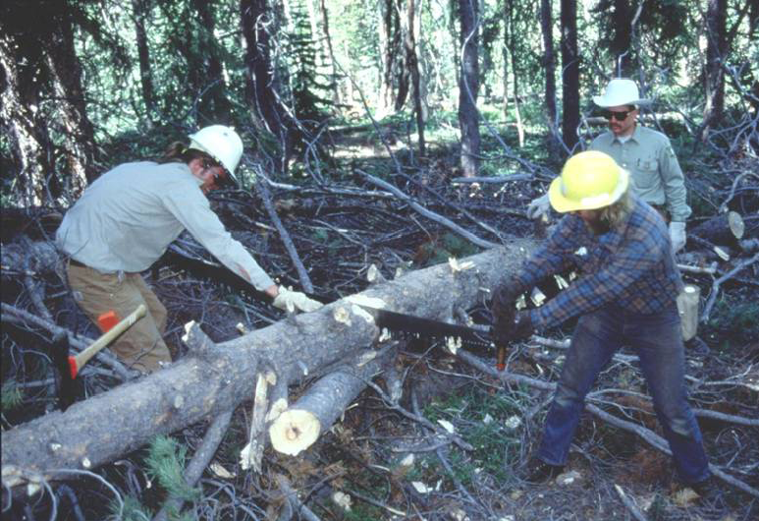
Bottom Bind
Notes:
When possible, make the cut at the bearing point and there will be no need for an undercut. If you can make the bearing point by inserting wood all the better.

Slide 64
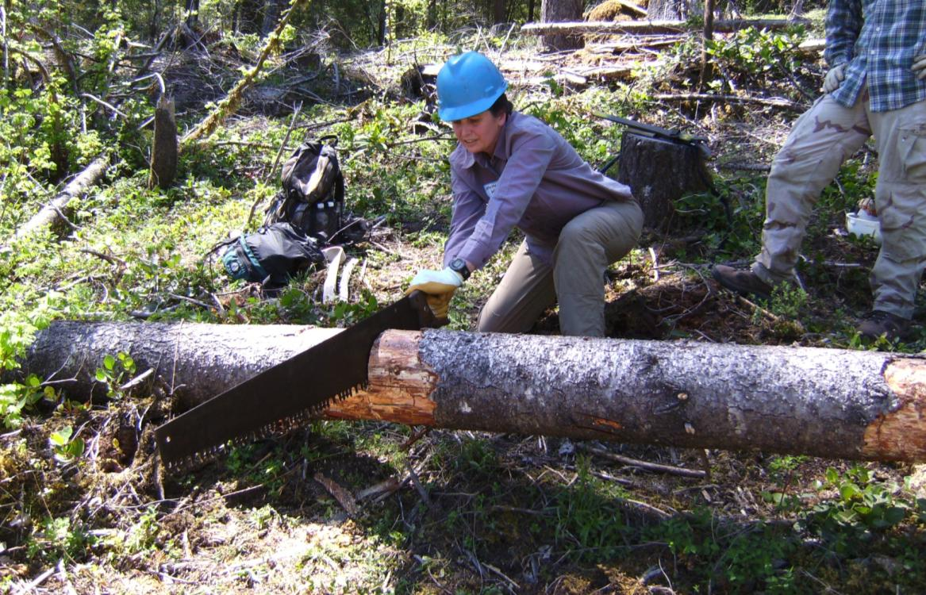
Bottom Bind

Slide 65
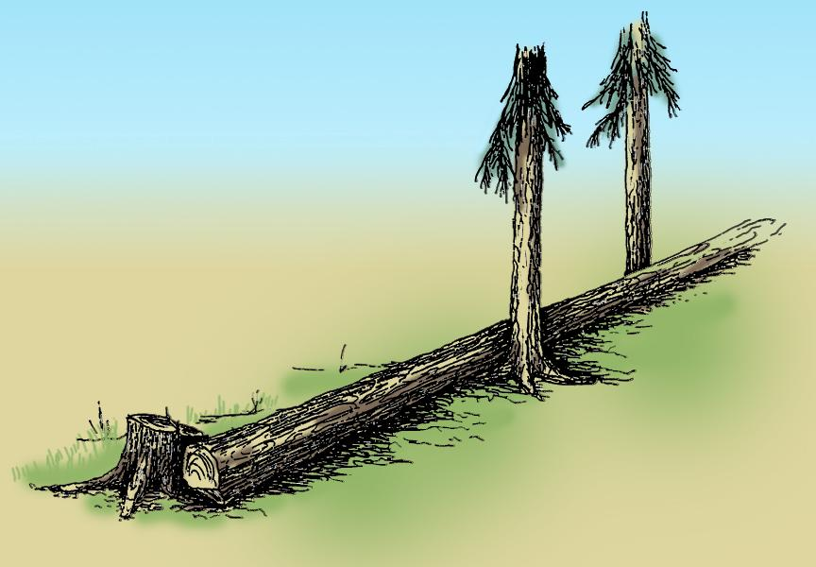
Side Bind

Slide 66
Side Bind
Cut at the point of compression if possible
Notes:
Particularly in crosscut work this is the point to have a discussion about the value of ax work. It is often the best tool when a log with severe side bind is on the ground.
INSTRUCTOR – Draw image on whiteboard, play video of chain saw cut, explain crosscut

Slide 67
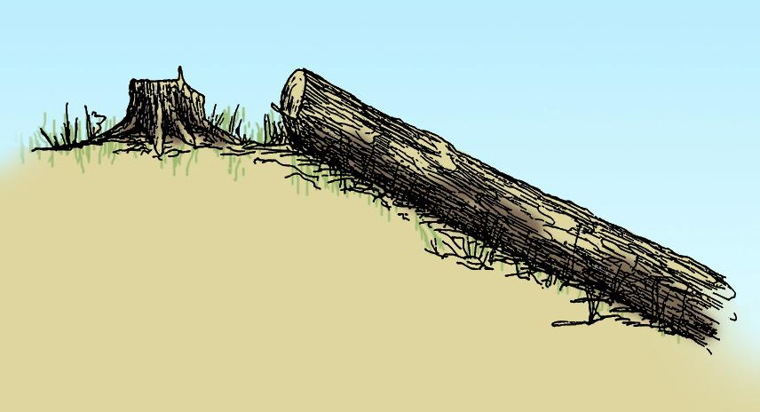
End Bind

Slide 68
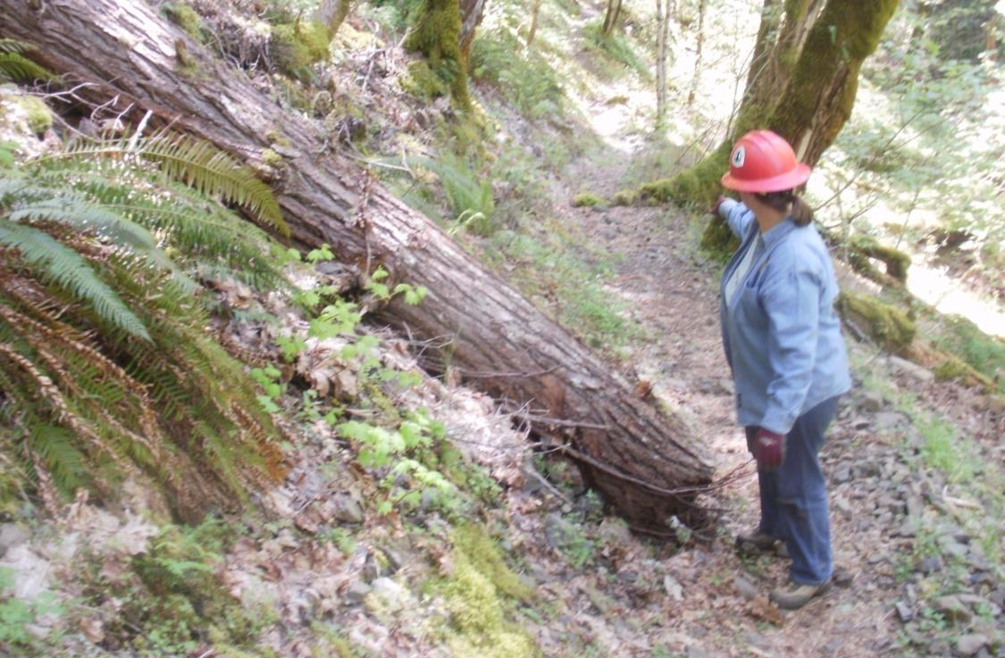
End Bind

Slide 69
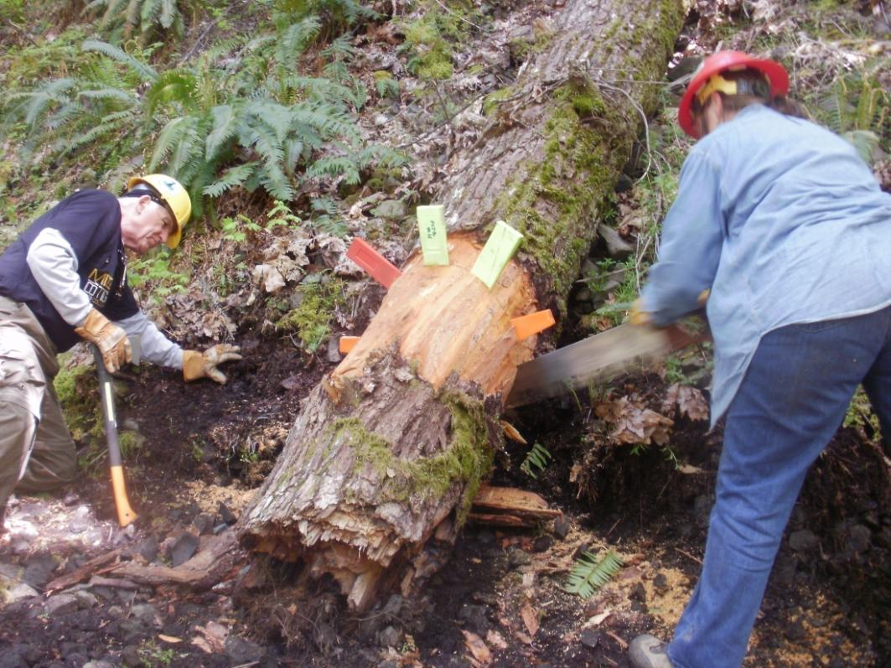
End Bind
Notes:
This is a great time to use lots of wedges to keep the kerf open. Note the bark below the saw and the assistant watching the kerf on the opposite side so the sawyer knows when she is getting close to the undercut.

Slide 70
Complex Bind
A log with a combination of two or more binds
Notes:
Need photo

Slide 71
Binds Review
Top bind
Bottom bind
Side bind
End bind
Complex bind

Slide 72
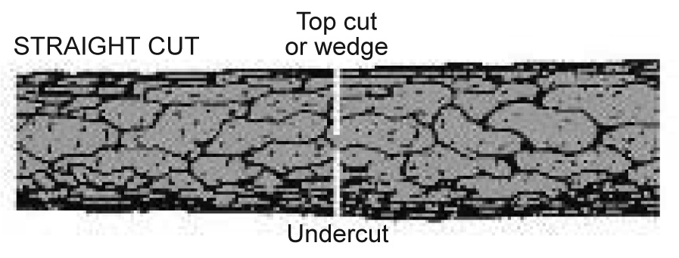
Types of Cuts
Straight Cuts
Continuous top or bottom bind
Small logs, low bind conditions
Compound Cuts
Large logs, hillside logs with end bind
Off-set Cuts (Crosscut saw)
Continuous top or bottom bind
Best protection for crosscut saw
Double Cut
Severe side bind, large rotten logs
Logs with torsion, shattered log
Notes:
Before going through the series of slides showing examples of each cut, have the students describe the log-condition that would likely employee each of these cuts. This should be review but it is good to make sure the students are clear on the terms before moving on to binds in the next section.
The Double Cut (not in the literature) is a last resort. This cut is commonly used with chainsaws because it require a lot more cutting. It’s a bunch more work but can get you out of a problem – very rotten log that won’t hold wedges – large twisted log – severe side bind – shattered or split log. The idea is that the extra space created allows the kerf to close in on the blade while leaving lots of space. Once this process is started, wedges become useless.
Need photos of cut types

Slide 73
Straight Cut
Sequence:
Offside Cut: Remove material on offside of log, when there is ample retaining holding wood
Compression: Cut compression side as early as possible and add pie-shaped cut if needed to allow log to move and relieve bind
Tension (Release) Cut: Remove holding wood cutting only on the tension side. Use wedge as back up for unexpected change in bind and for end bind.
Notes:
INSTRUCTOR: Cut must be in this sequence
Need images or video

Slide 74
Compound Cut
Face down hill – make “V” with arms
First angle allows cut section to be wider on down hill side
Second angle allows cut section to be wider on top of the log
Straight cut through with wedges
Notes:
Need images or video

Slide 75
Off-set Cut (Crosscut)
Compression: Cut compression side
Tension Cut:
Off-set top kerf approximately ½” from bottom kerf
Top kerf will be closer to center of trail relative to the bottom
Notes:
The offset cut is great for keeping your saw out of the dirt.
INSTRUCTOR: Ask students if cutting off-set with top bind which side do you cut first? Vice versa.
Need images or video

Slide 76
Off-set Cut
Cut Section
Fixed Log
Notes:
The saw falls with the log and is safe on the shelf left by the offset cut

Slide 77
Double Cut
Single buck from safe (compression) side to cut two parallel top kerfs
When saw starts to bind, remove saw, using a Pulaski remove wood fiber from between two kerfs
Repeat until log severed
Notes:
Make two cuts side by side wide enough apart that your chipping tool will easily fit in. A Pulaski is commonly used for the wood removal.
Use to remove large (60”) timber with smaller chain saw
INSTRUCTOR: Stress single buck, DO NOT WANT SAWYER ON TENSION SIDE.
Need images or video

Slide 78
Types of Cuts Review
Straight Cuts
Compound Cuts
Off-set Cuts (Crosscut saw)
Double Cut

Slide 79
Cutting Compression Side First
Notes:
In this case, the sawyers got a deep top cut before running into any bind which reduced the amount of underbucking.
INSTRUCTORS – Discuss avoiding zippers

Slide 80
Get a wedge in as soon as the saw is fully in the log

Slide 81
Carry Lots of Wedges
Turn a top bind into a bottom bind with wedges
Notes:
The sawyers raised the log off the ground by driving stacked wedged in under the log. Then they drove a small log under that would not move during the cut process.
INSTRUCTOR – Ask students how many wedges are “lots” of wedges, should carry

Slide 82
Wedge Placement
1
2
3
4
5
Examples have top compression
Notes:
INSTRUCTOR: Emphasis size and number of wedges are determined by size of log. That’s why proper trail survey notes are important
Add photo of hanging wedge or axe

Slide 83
Cut Piece Track
Make sure everyone has safe escape route
Secure switchbacks for trail users

Slide 84
Plumb Cut
On steep slopes go above the back slope and make a plumb cut
Trail Tread
Notes:
This type of cut is needed with severe end-bind so the upper log will slide past the lower off-cut. It is not needed if the upper portion is well anchored.
It is often used to maximize up-hill clearance for pack-stock in steep landscapes.

Slide 85
Course Review
Types of Binds
Types of Cuts
General Considerations

Slide 86
Crosscut Saw Specific Training
For Trainee Saw Operators and Saw Operators
March 2013

Slide 87
Crosscut Saw Tools
Required
PPE
First aid kit
Communications
Crosscut saw(s) + handle(s) + sheath(s)
Notes:
Explain saw types, handles, sheaths, and lengths
Importance of having two saws
3-5 lb axe not necessary as MTDC states that’s for felling. Use 2-3 lb for bucking only operations.
Importance of straight handle axe for buck, axe use in MTDC assuming you are felling so the axe suggested is for felling
Pruning saw eliminates the need to limb with an axe

Slide 88
Crosscut Saw Parts
Notes:
Pass around a couple 1’ pieces of saw so students can see up close the set and swedging on the raker.

Slide 89
The Kerf
Two cutters score each side of the kerf
Rakers peel out the middle
The set of the cutters makes the kerf wider than the saw blade
Notes:
The saw dynamics and cutting action should be a refresher for most students if they have taken the TSC 103 class. If not, then discuss the cutters and rakers. Explain why it is critical for a crosscut kerf to held open (a pinched saw loses its set).

Slide 90
Crosscut Saw Tools
Required
PPE
First aid kit
Communications
Crosscut saw(s) + handle(s) + sheath(s)
Single-bit, straight-handled axe + sheath
Crosscut bucking wedges
Solvent/lubricant
Pruning saw + sheath
Notes:
Explain saw types, handles, sheaths, and lengths
Importance of having two saws
3-5 lb axe not necessary as MTDC states that’s for felling. Use 2-3 lb for bucking only operations.
Importance of straight handle axe for buck, axe use in MTDC assuming you are felling so the axe suggested is for felling
Pruning saw eliminates the need to limb with an axe

Slide 91
Crosscut Saw Tools
Recommended
Small shovel or combi-tool
Underbucker

Slide 92
Underbucking
Notes:
When & Why would we under-buck?
Top compression we can’t overcome with wedges or some other means.

Slide 93
Underbucking

Slide 94
Underbucking
Notes:
Drive the underbucking tool firmly into the log and be sure the angle puts the saw where you want it.

Slide 95
Underbucking
Notes:
Start slow and easy with short strokes – then gradually lengthen the motion.

Slide 96
Underbucking
Notes:
Sometimes you need to underbuck.

Slide 97
Crosscut Saw Tools
Recommended
Small shovel or combi-tool
Underbucker
Loppers
Clippers
File, hone
Bark spud + sheath
Notes:
If you don’t have a bark spud, you have to use an axe.

Slide 98
Crosscut Saw Tools
Project Dependent
Pulaski
Peavey, cant hook
Log carrier
Double-bit axe + sheath
Basic rigging: strap, rope, come-along
Notes:
Peavey – purchase the Stihl aluminum, weigh 75% less

Slide 99
Questions

Slide 100
Chain Saw Specific Training
For Trainee Saw Operators and Saw Operators
March 2013

Slide 101
Parts of Chain Saw
hand guard
front handle
Cooling fins
muffler
Tension
adjustment
screw
throttle
interlock
dogs
chain
Guide bar
throttle trigger
Chain catcher
rear handle
Bar studs

Slide 102
Parts of Chain Saw
Air filter cover
Gunning
mark
Oil
tank
On/off switch
& choke
Throttle
interlock
Flywheel/fan
Magneto
Fuel tank
Throttle
trigger

Slide 103
Chain Saw Tools
Required
PPE
First aid kit
Communications
Fire extinguisher
Chain saw + bar cover

Slide 104
Chain Saw Safety Components
Chain brake
Chain catcher
Bumper spikes aka dogs
Bar cover (protection from chain and dogs)

Slide 105
Chain Saw Starting Procedure
Chain brake MUST be on when starting
No drop starting
Find the best method that works for you

Slide 106
Chain Saw Tools
Required
PPE
First aid kit
Communications
Fire extinguisher
Chain saw + bar cover
Fuel + chain oil
Bar wrench
Single-bit, straight-handled axe + sheath
Bucking wedges
Pruning saw + sheath
Notes:
3-5 lb axe not necessary as MTDC states that’s for felling. Use 2-3 lb for bucking only operations.
Importance of straight handle axe for buck, axe use in MTDC assuming you are felling so the axe suggested is for felling
Pruning saw eliminates the need to limb with an axe or chain saw
Fuel must be in approved containers – MSR red 1 liter fuel bottles – check lid and gasket for fit

Slide 107
Chain Saw Tools
Recommended
Extra chain(s) and/or filing kit
Saw maintenance kit
Extra bar
Chain saw pack
Loppers
Clippers
Small shovel or combi-tool

Slide 108
Chain Saw Tools
Project Dependent
Pulaski
Peavey, cant hook
Log carrier
Double-bit axe + sheath
Basic rigging: strap, rope, come-along
Notes:
Peavey – purchase the Stihl aluminum, weigh 75% less

Slide 109
Questions

