Slide 1
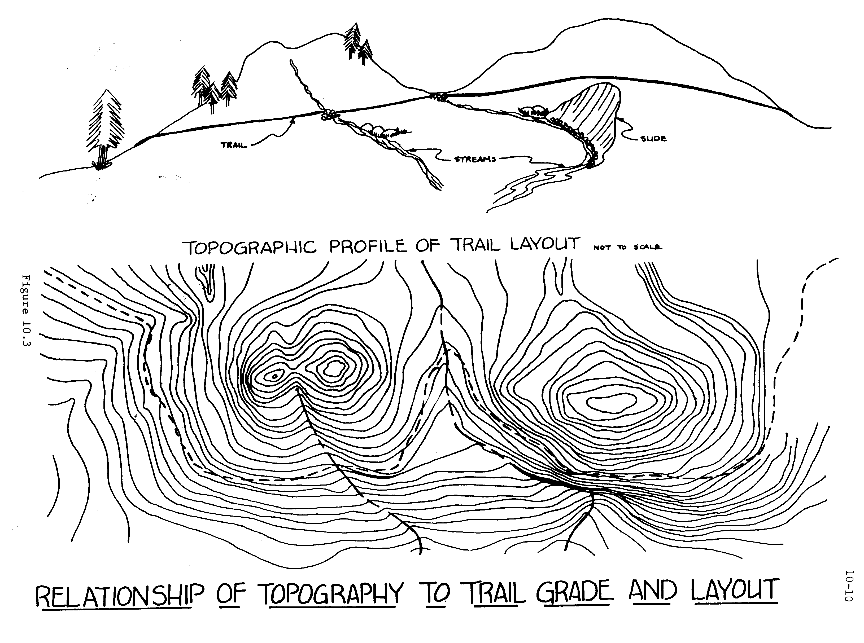
200. Basic Trail Design
Notes:
For curious trail workers who want to understand why so many trails are in bad shape because of how they were made. Learn how better design and layout makes trails more sustainable and less prone to erosion. Introduction to different trail design standards appropriate for different kinds of trails. This class is for anybody interested in these topics, but students with some trail building and maintenance experience will benefit the most.
First we will discuss Trail Planning, then Trail Layout, then Flagging. The afternoon portion of this class is a field exercise using clinometers and flagging a hypothetical new trail.

Slide 2
Trail Planning Concepts
How The Planning Process Affects Design
Major and Minor Control Points in Trail Corridors
The Importance of Reconnaissance
How to Design for Land Capability, Aesthetics, and Safety Concerns
The Need for Resource Specialists Review Before Flagging a Trail Alignment

Slide 3
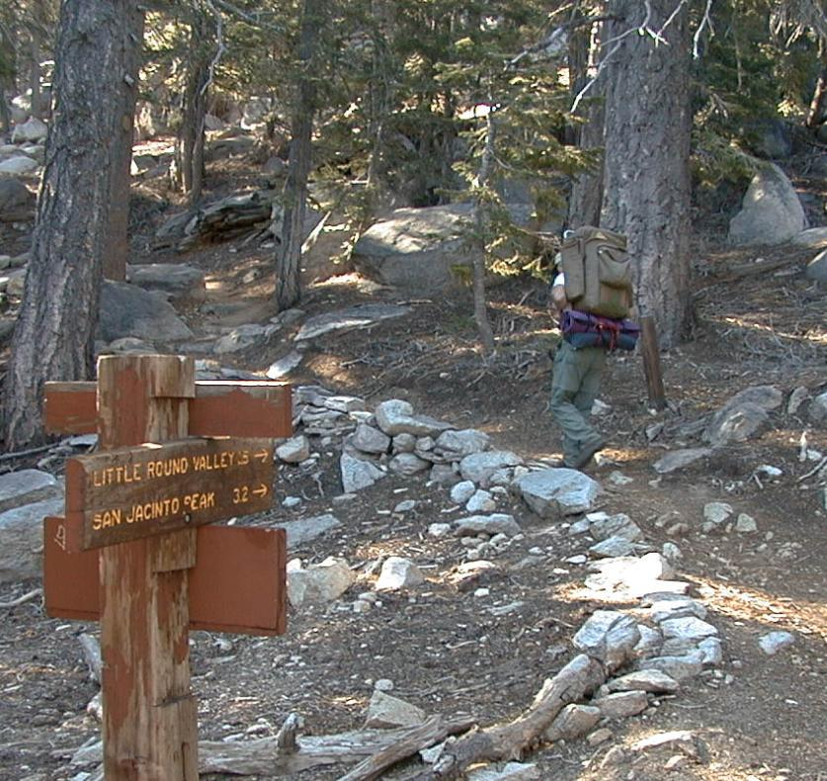
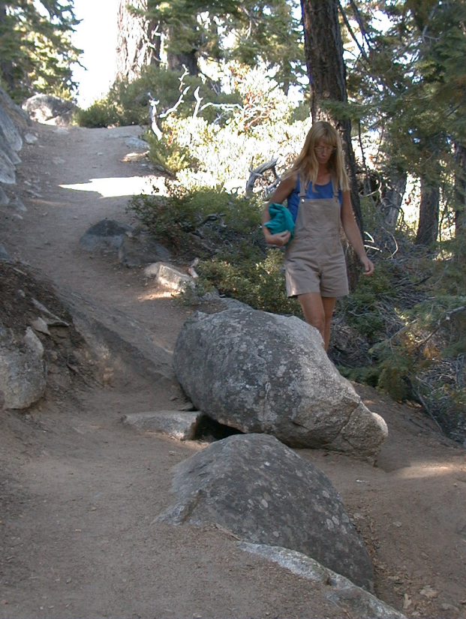
Hikers and Backpackers
Identify the Trail User
Notes:
The first factor in Trail Planning is determining the user type for which the trail is intended. Each user type needs a trail of an appropriate surface, grade (steepness), and clearance.

Slide 4
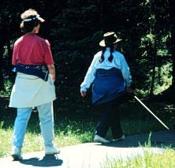
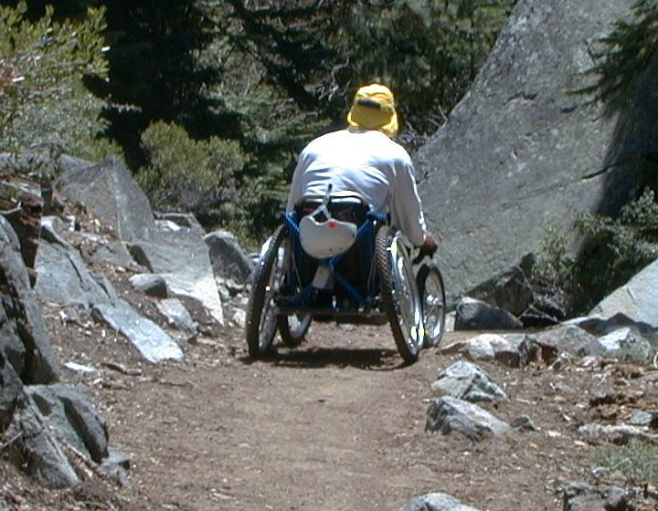
New or Altered Trails May Need to Comply with ADA
New Outdoor Access Guidelines for Trails
User Types Dictate
Design Criteria

Slide 5
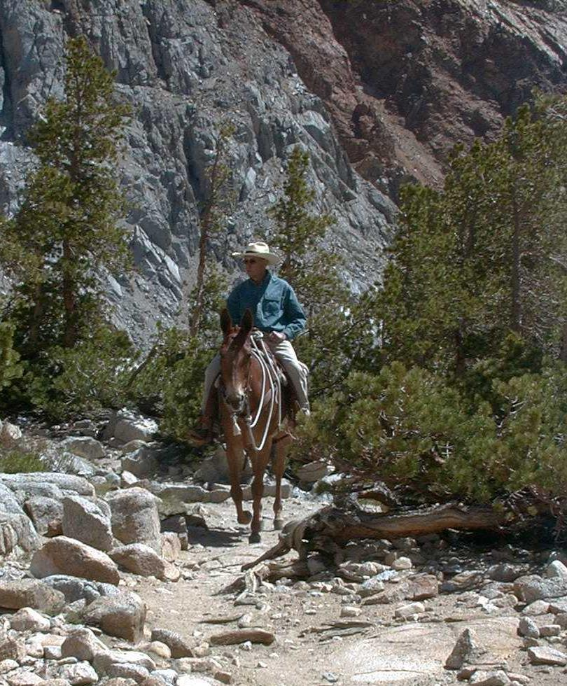
Equestrians

Slide 6
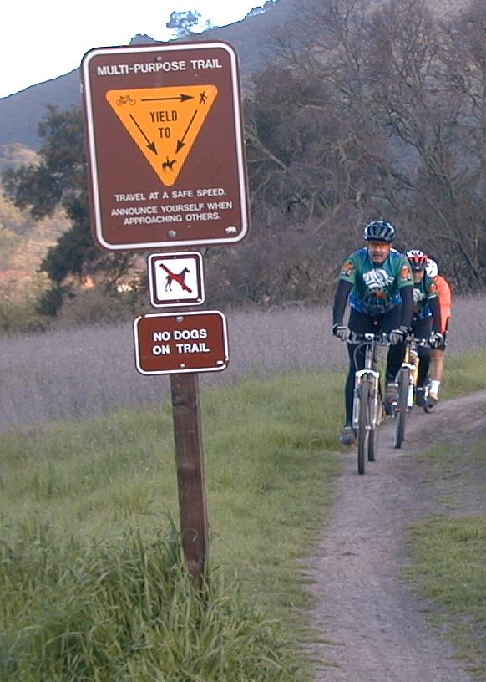
Mountain Bikes

Slide 7
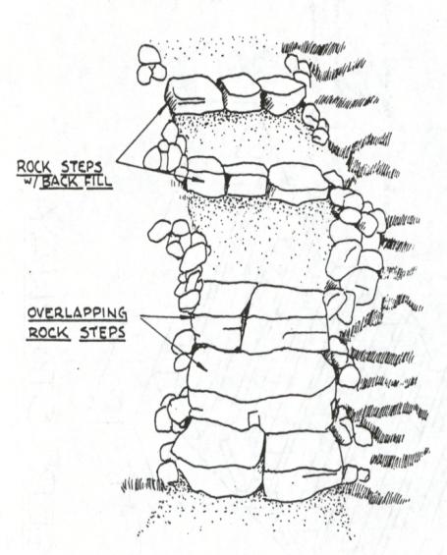
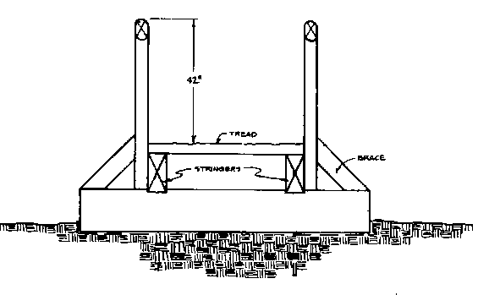
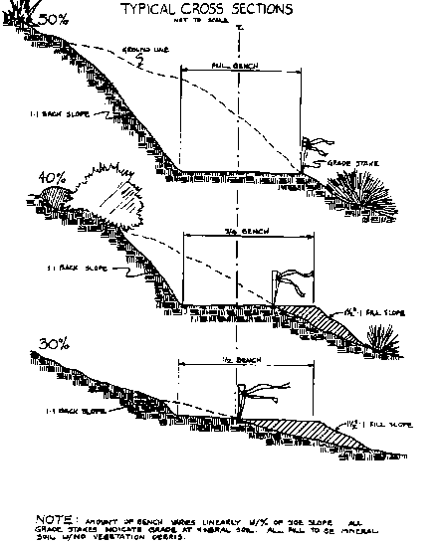
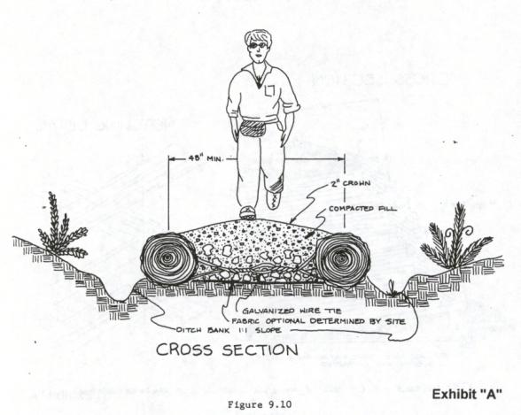
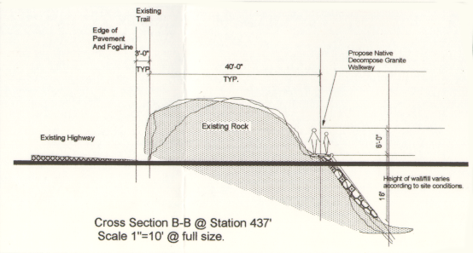
Determine Specifications & Standards – Based on User Group, Classification and Season of Use
Notes:
The land management agency (eg, USFS) has sets of trail standards based on user type, trail class, and season of use. These may vary regionally. Make sure to consult with your local unit on the right set of standards for your trail.
Discuss the usefulness of a trail classification system for planning trail maintenance and providing different trail experiences.

Slide 8
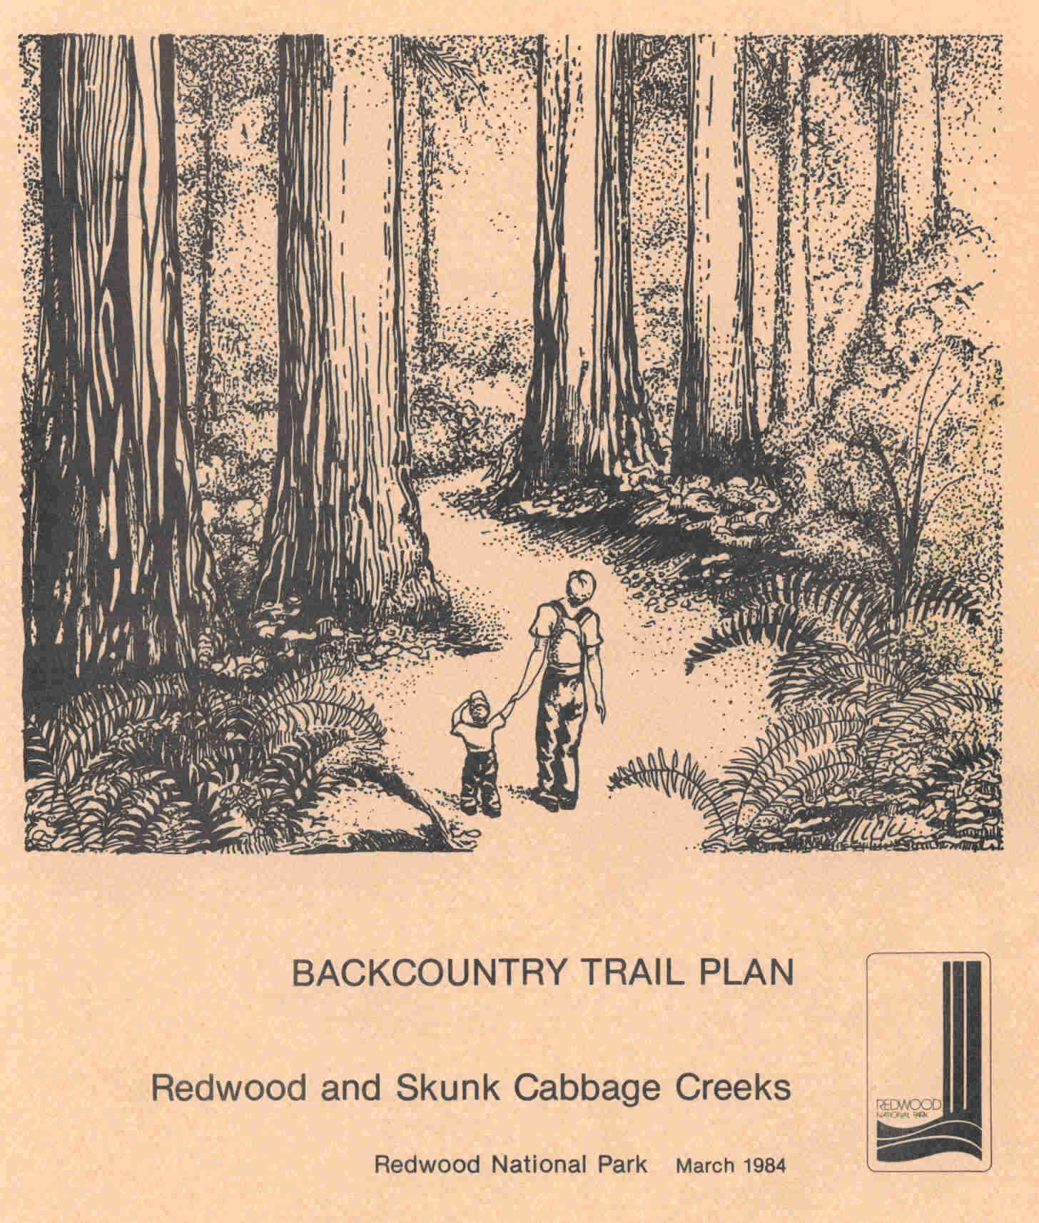
Land Unit Trail Plan
Notes:
Trail planners need to research whether the area they have in mind for the trail already has land management plans in place, for example, plans pertaining to recreation, wildlife, forestry. . .

Slide 9
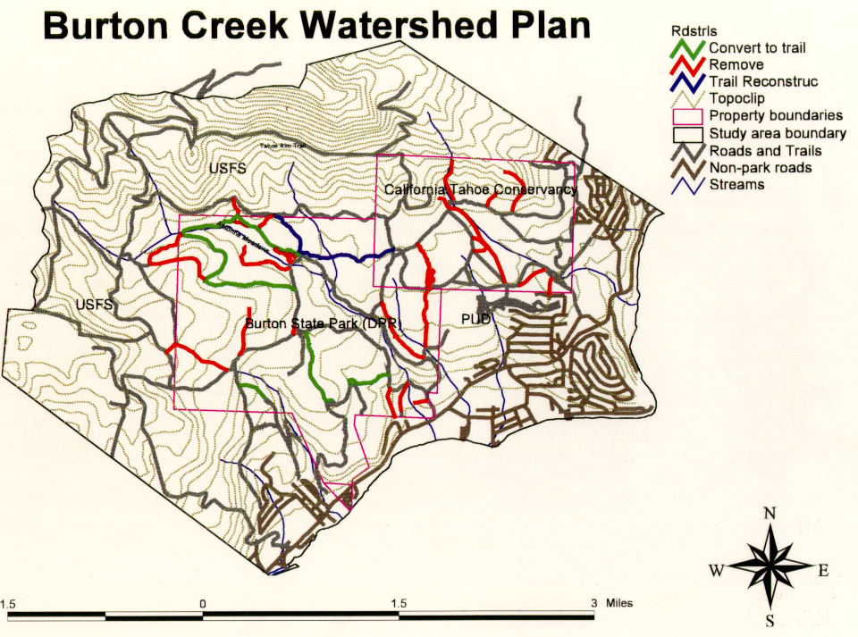
Notes:
or watersheds. Additionally, some pieces of Federal land have special Congressional designations such as Wilderness Area, Wild and Scenic River, or National Scenic Trail. Such lands, including the Pacific Crest National Scenic Trail, have special management plans that further guide trail planning and design.

Slide 10
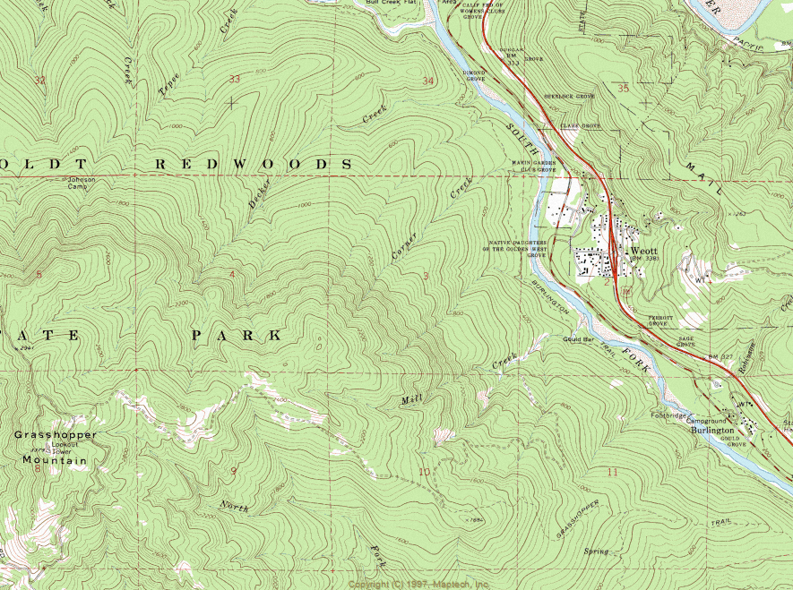
Topographic Maps
Topographic Maps
Notes:
The next step in Trail Planning is to obtain a detailed Topographic Map of the area. (Show students briefly how to read contour lines: eg, lines closer together means steeper hillside, etc).

Slide 11
Identify Control Points
Control Points are areas that the Trail Corridor NEEDS to go to (positive) or miss (negative)
Major control points are identified BEFORE on-the-ground reconnaissance
Notes:
Using the topo map, begin to identify Control Points. Major control points can usually be identified on the map, before on-the-ground reconnaissance. Examples of major control points in following slides.

Slide 12
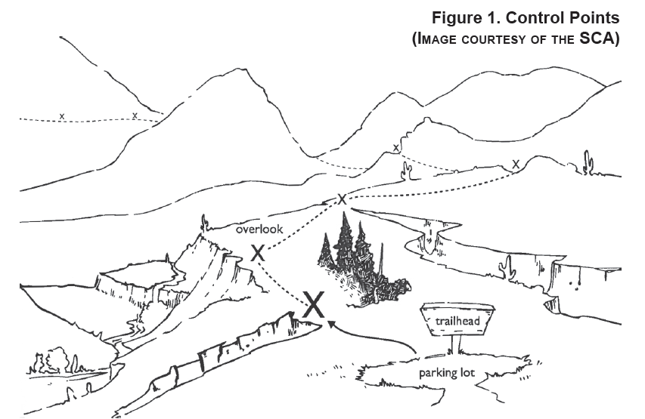

Slide 13
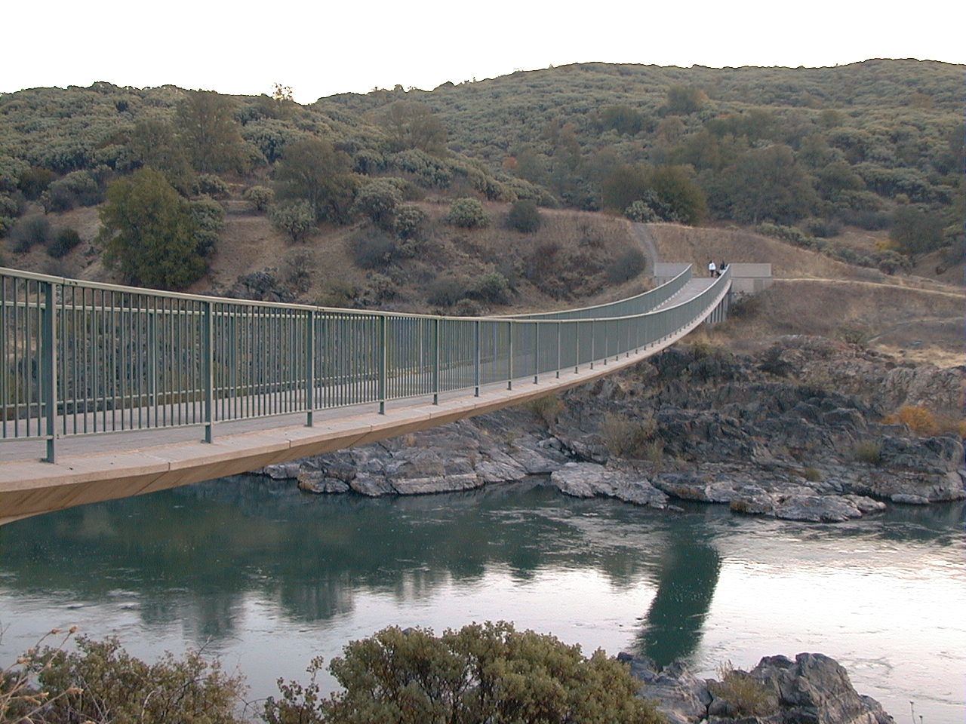
Rivers or Bodies of Water
Major Control Points
Notes:
Positive control points are highly desirable places by which they want the trail to pass. Examples include a trailhead location with adequate parking, stream crossings for affordable bridges (narrow and high-banked) or safe fords (shallow and firm), scenic viewpoints, and side-hill terrain with durable soils on which to build a sustainable trail.

Slide 14
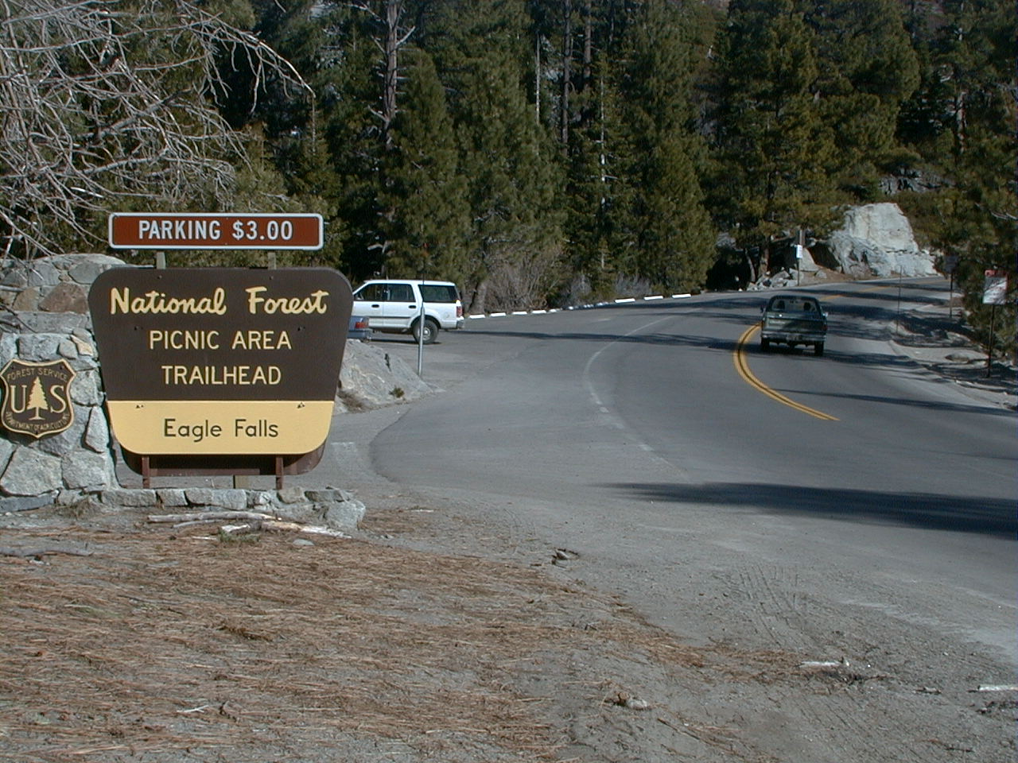
Major Road or Highway Crossings

Slide 15
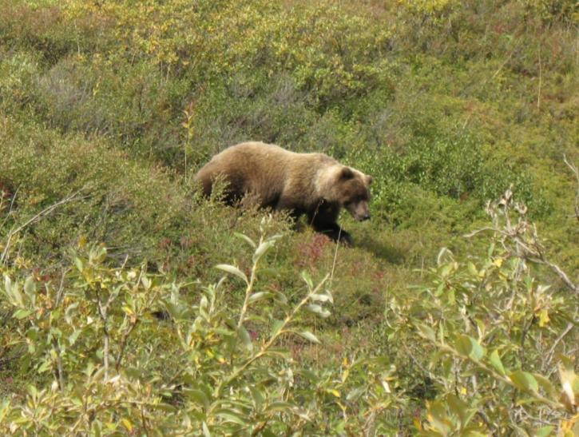
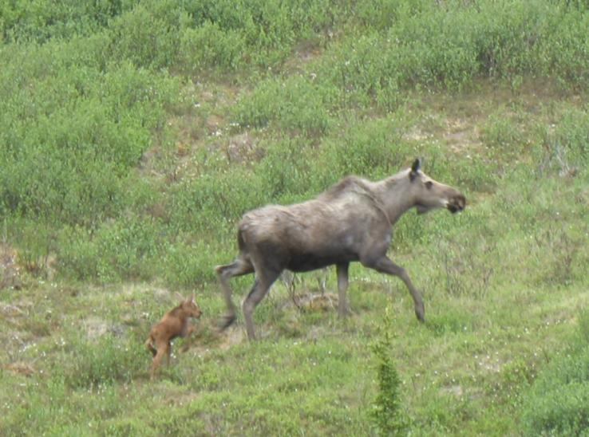
Large Wildlife Management Areas
Notes:
Negative control points are places that should be avoided such as swamps, rock slides, avalanche chutes, critical wildlife habitat, and fragile archeological sites, among many others.

Slide 16
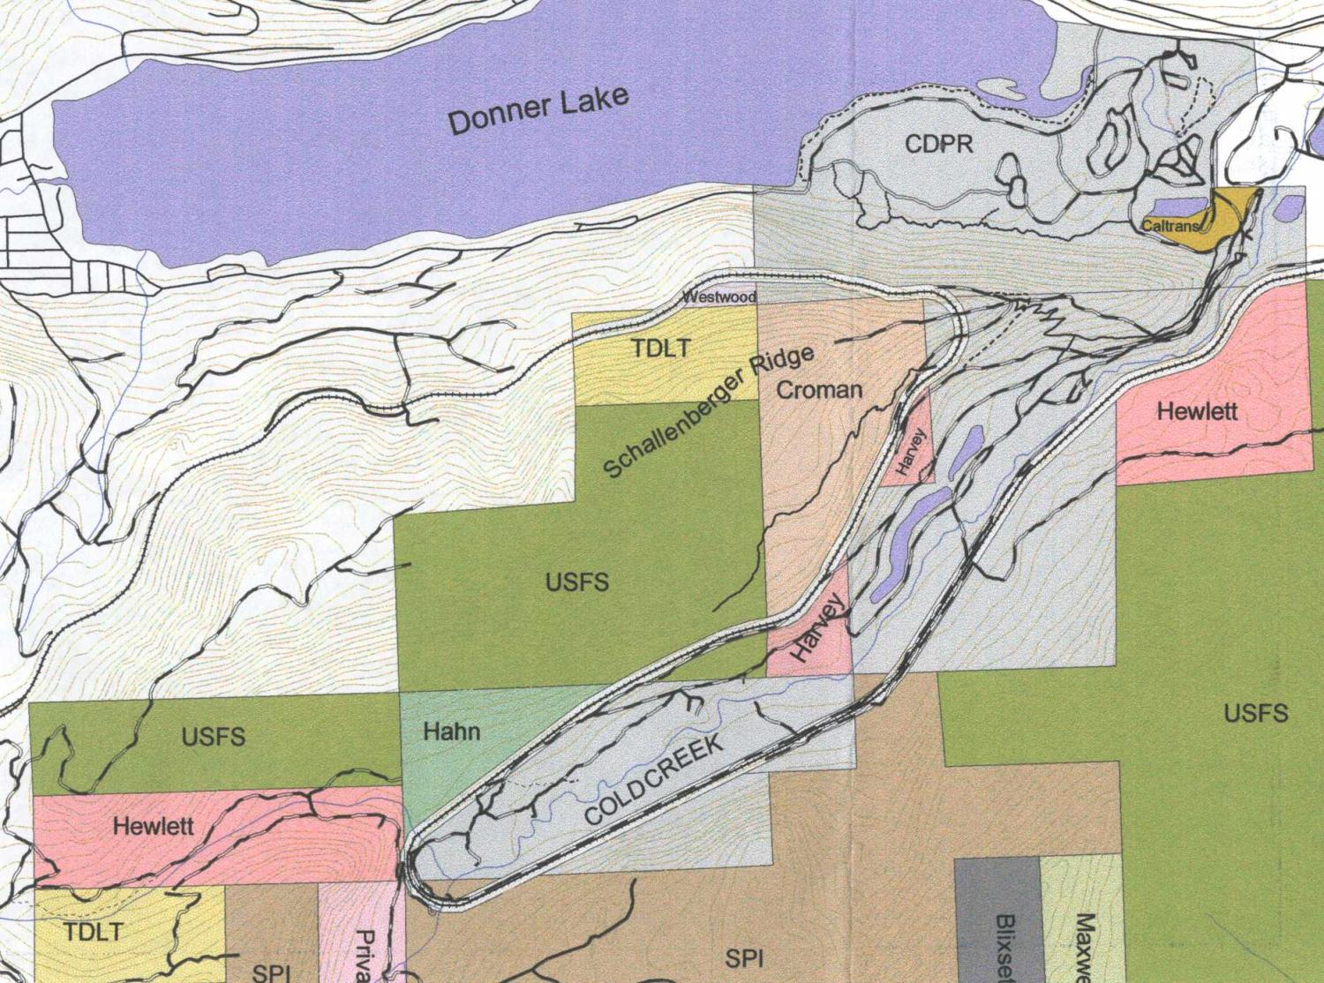
Property Boundaries, In-holdings, Easements

Slide 17
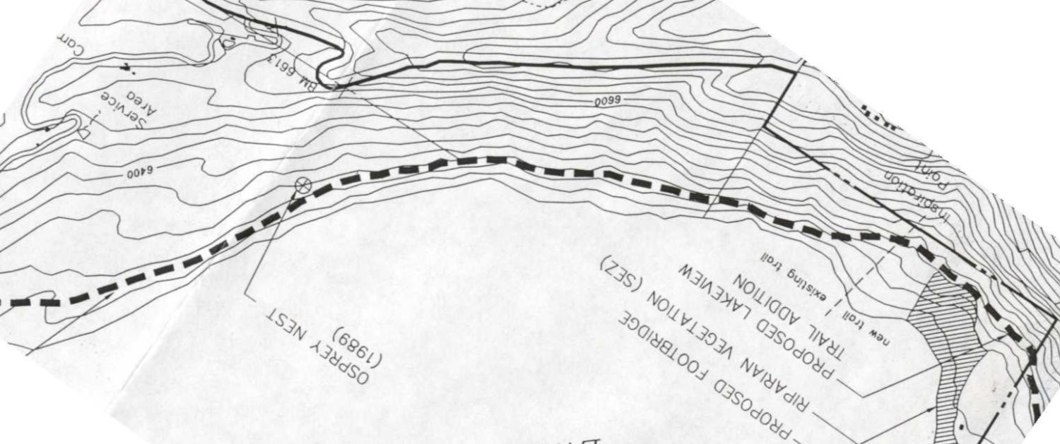
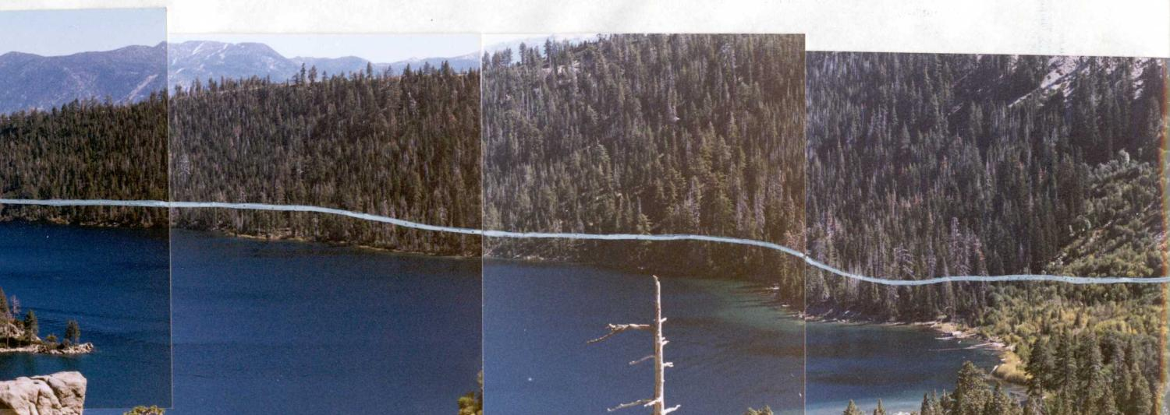
Get the Big Picture
Try to get a High Visual Overview of the Shorter Corridor Unit
Notes:
Major control points not obvious on maps can become evident with a big picture overview, that is, a high visual overview of the shorter corridor unit. Designers may be able to view the target area from the opposite side of a valley, from a body of water, or from detailed aerial photos (eg, Google Earth).

Slide 18
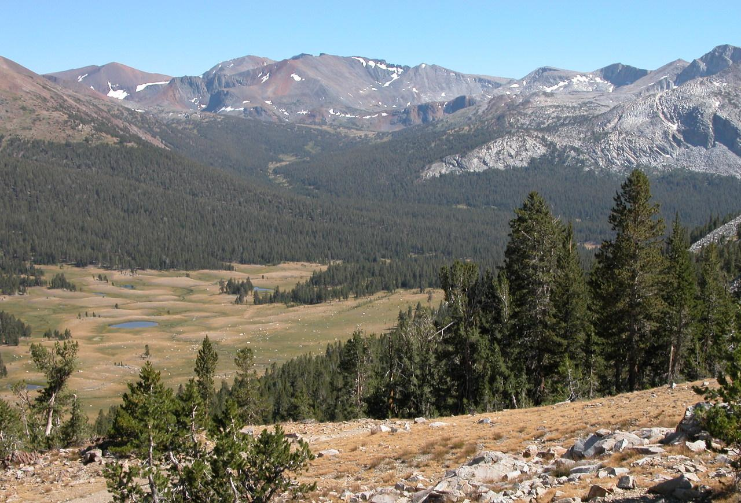
High Prominent Ridges, Lookouts

Slide 19
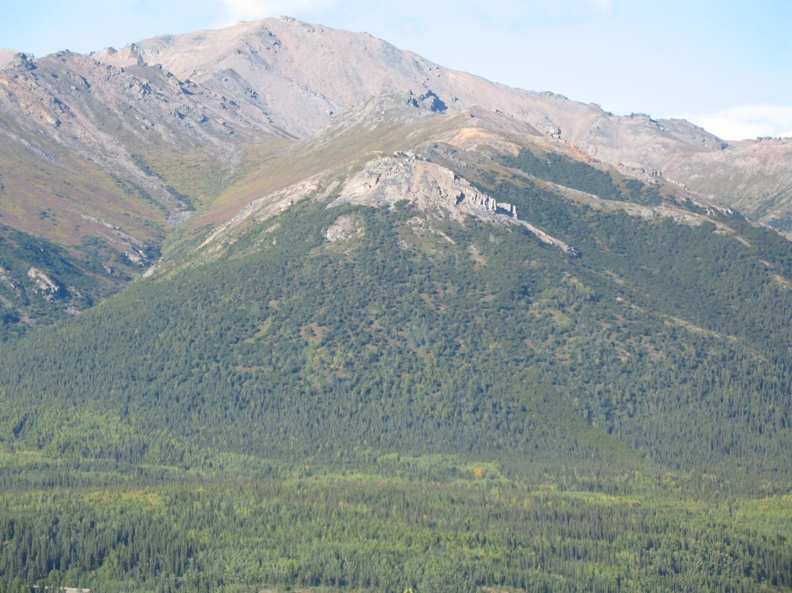
Vegetation is an indicator of soil types and land capability
Notes:
Aerial photos can reveal different vegetation types, indicative of different soil types.

Slide 20
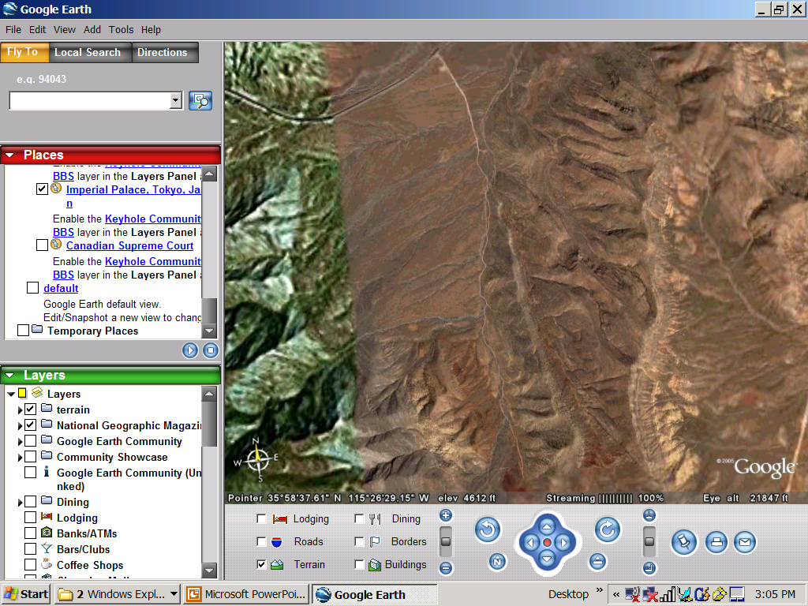
http://earth.google.com/

Slide 21
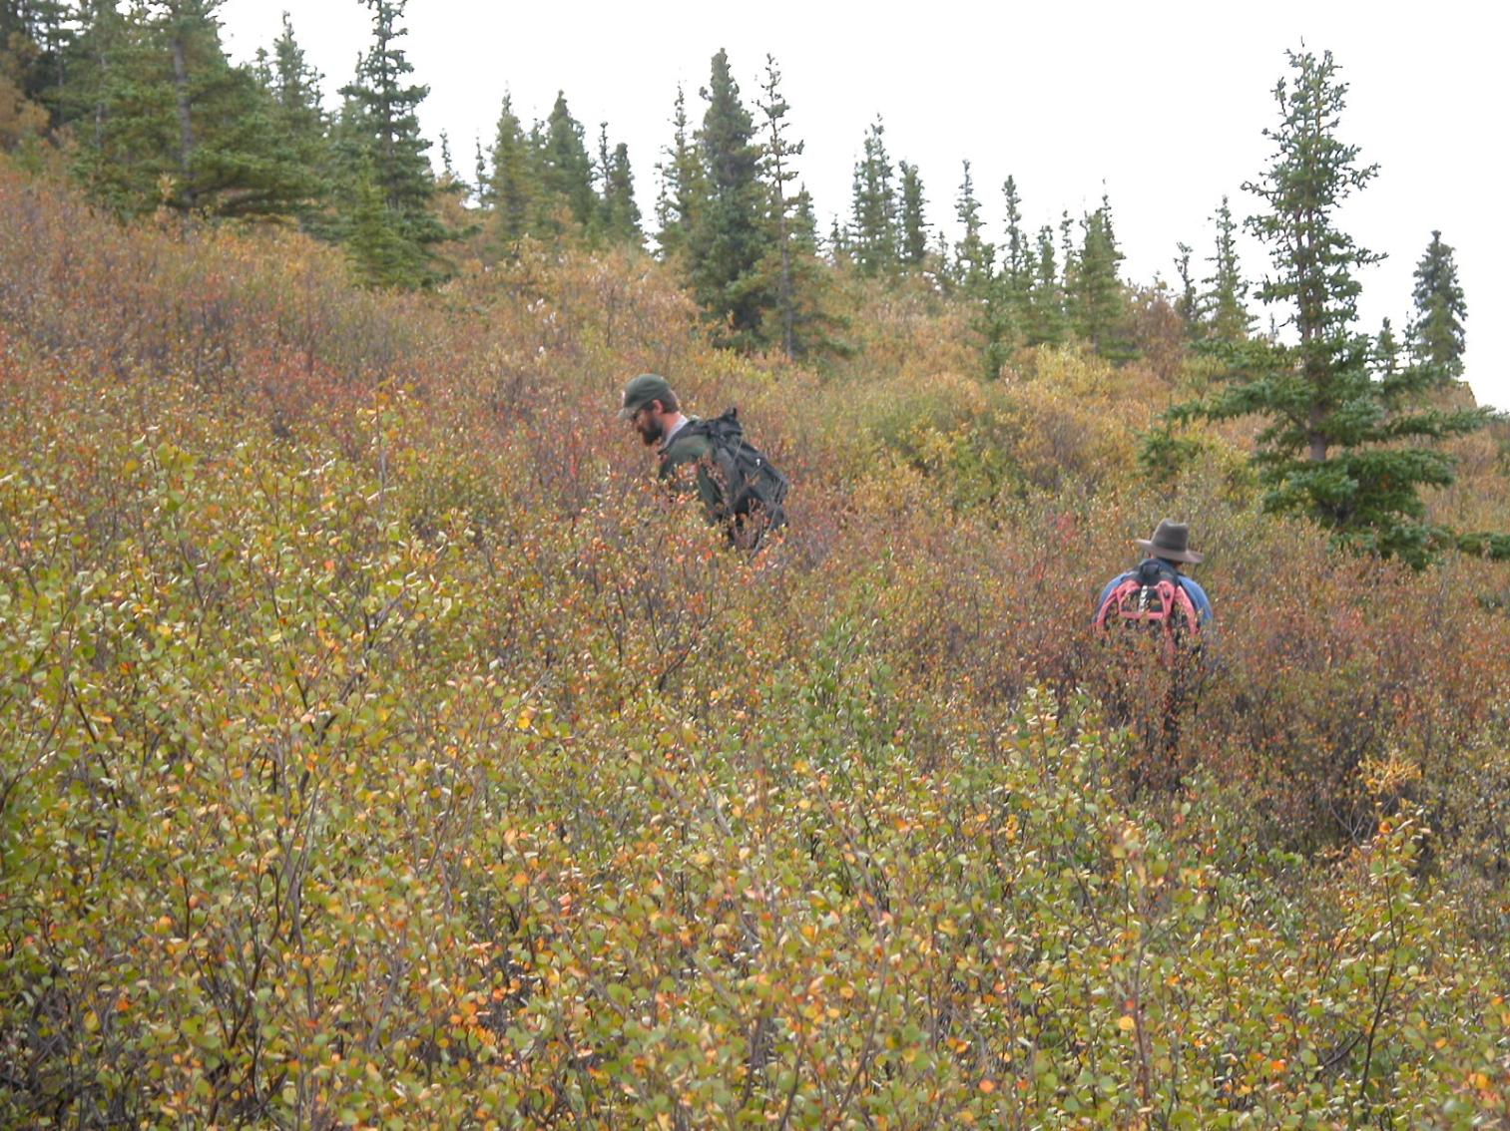
Reconnaissance
Ground Checking the Trail Corridor, from one Major Control to Another
Identification of Minor Control Points
Notes:
Now that you’ve identified a very rough trail corridor based on researching land management plans, maps, and photos, it’s time to get out on the ground and check it out.

Slide 22
Minor Control Points
Features in the Trail Corridor that will Influence the Alignment of the Trail
Discovered and Worked Around During On-the-Ground Reconnaissance
Notes:
During reconnaissance, designers establish minor control points. These may cause minor shifts in the trail alignment, but won’t change the overall route. Examples to follow. . .

Slide 23
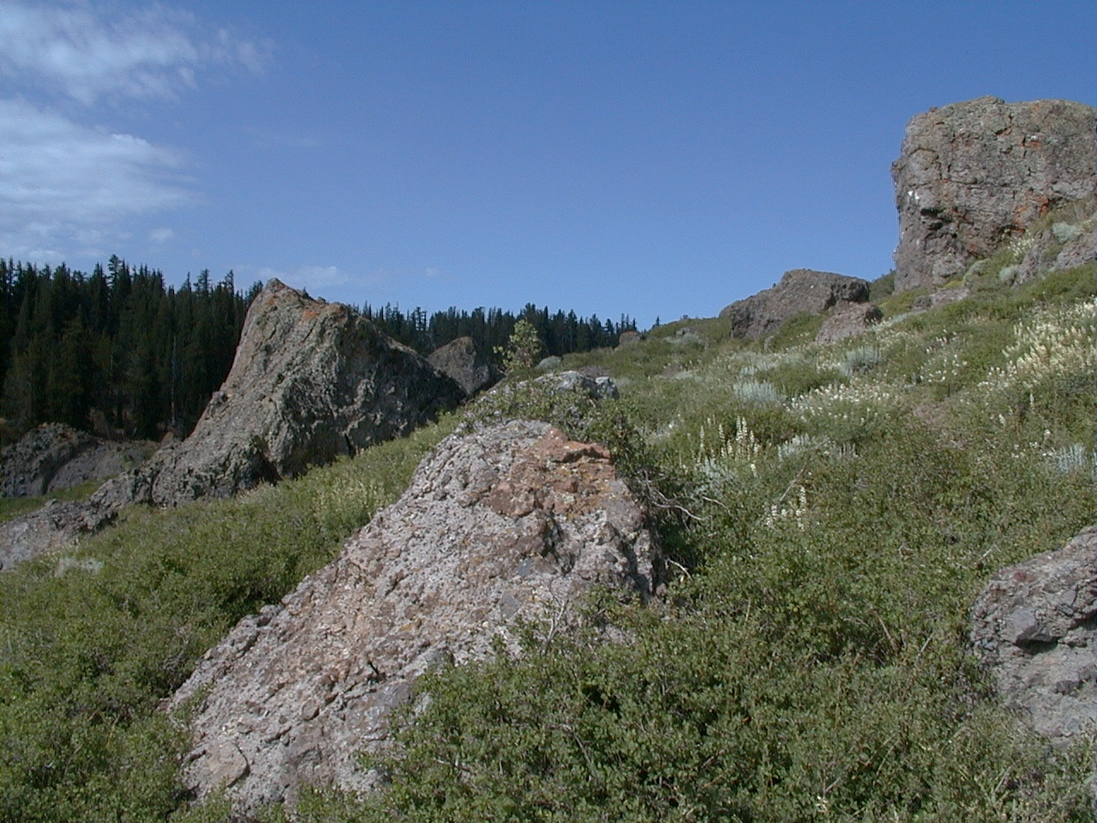
Rock Outcrops
Notes:
Examples include rock outcrops, springs/seeps, big trees, and rock slides/debris flows. Designers keep track of rough grades between control points with a clinometer. Reconnaissance also allows designers to determine an alignment that highlights the natural aesthetics of the area.

Slide 24
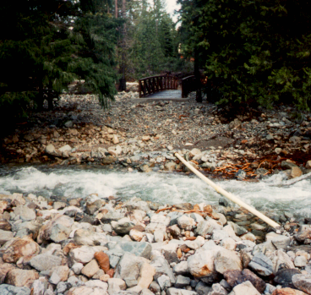
Stream Crossings Fully Investigate for Proper Trail Alignment
Notes:
What’s wrong with this picture? The stream moved!

Slide 25
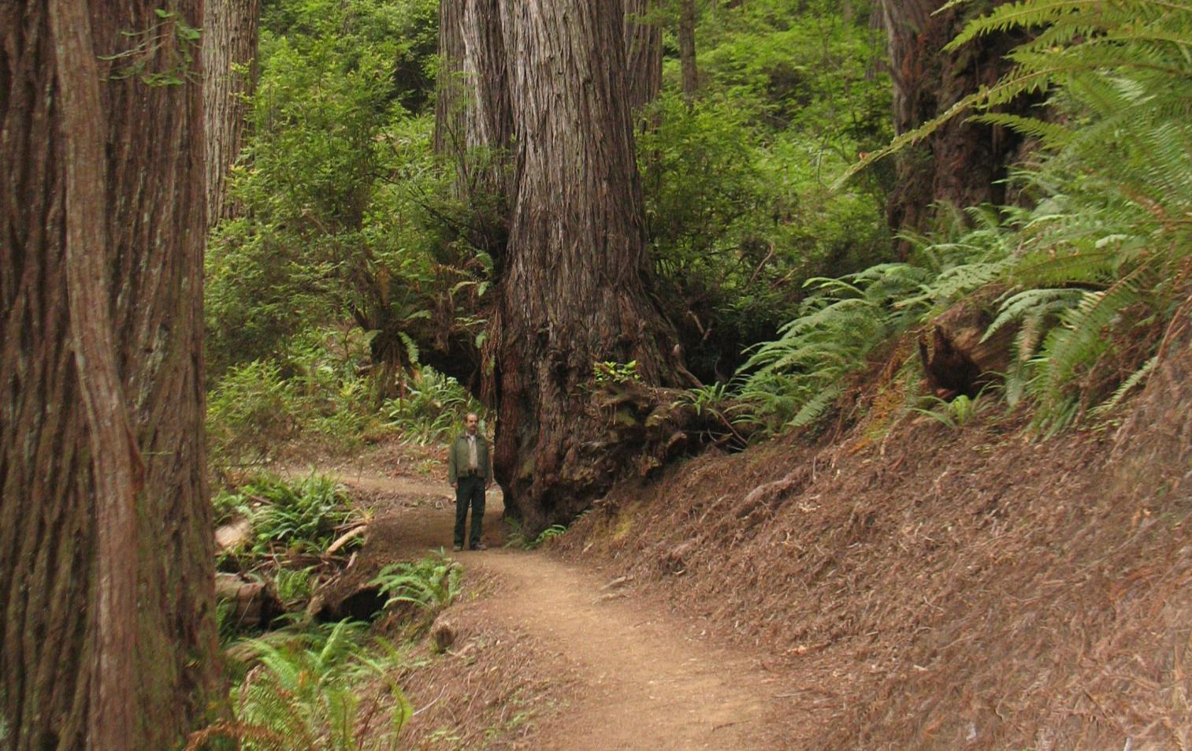
Large Trees are Minor Controls
10’
Notes:
Notice how much the trail grade would be affected if it were aligned over top of the tree. To produce the most graceful and sustainable tread alignment, decisions about which way to go around minor controls need to be considered before flagging begins.

Slide 26
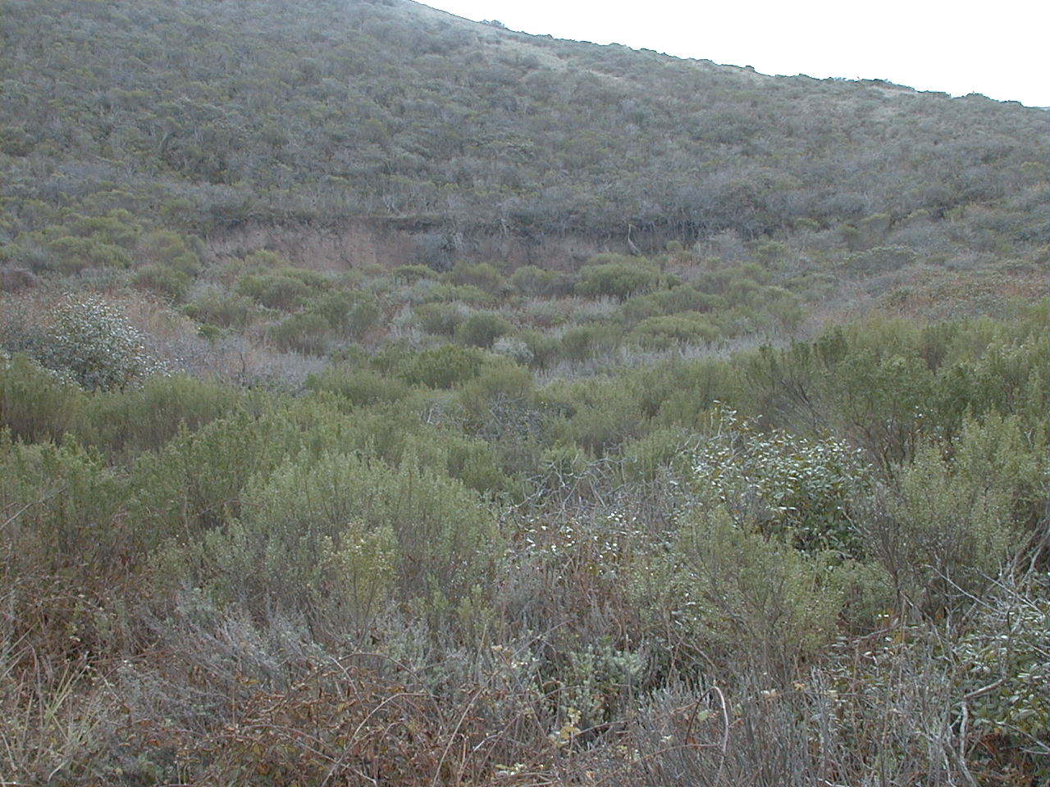
Scarps
Slope Instability
Notes:
On the ground reconnaissance reveals smaller areas of instability that may need to be avoided.

Slide 27
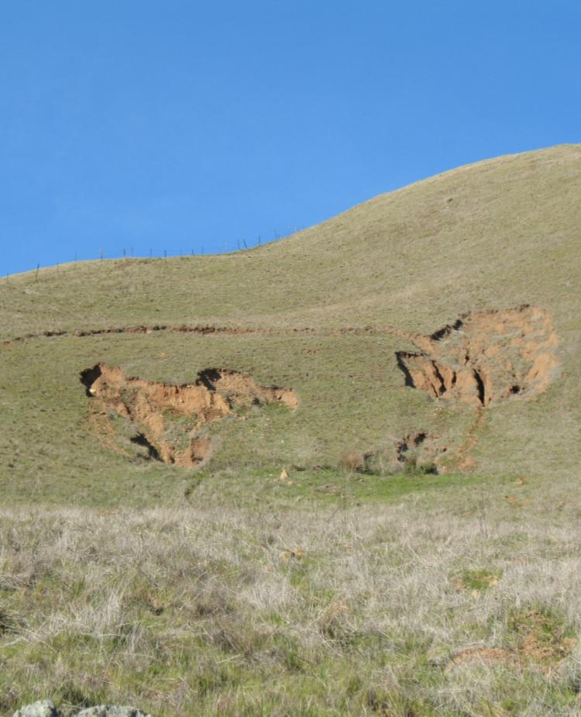
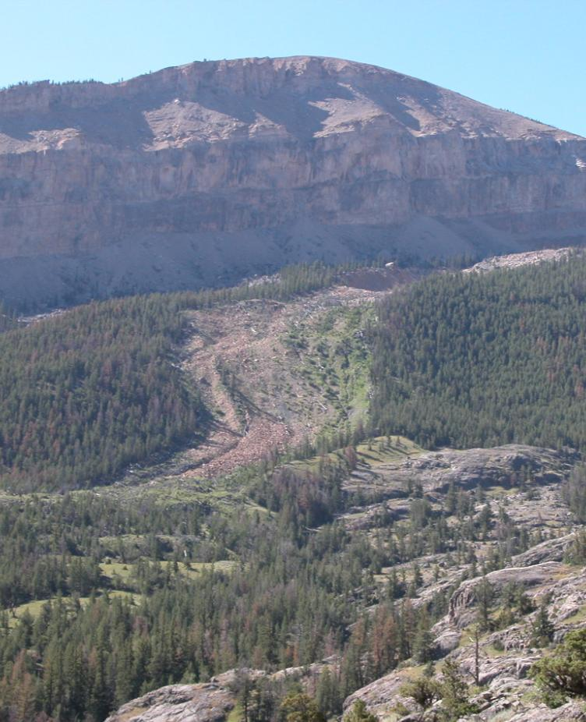
Debris Flows

Slide 28
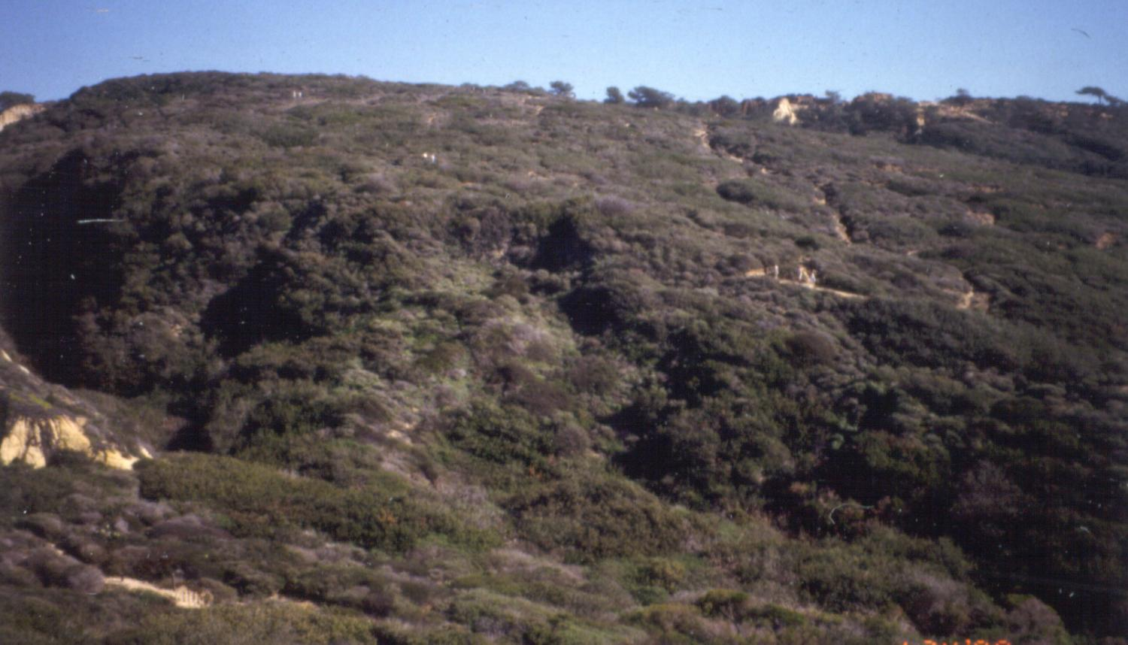
Look Hard Vegetation Hides Old Slides

Slide 29
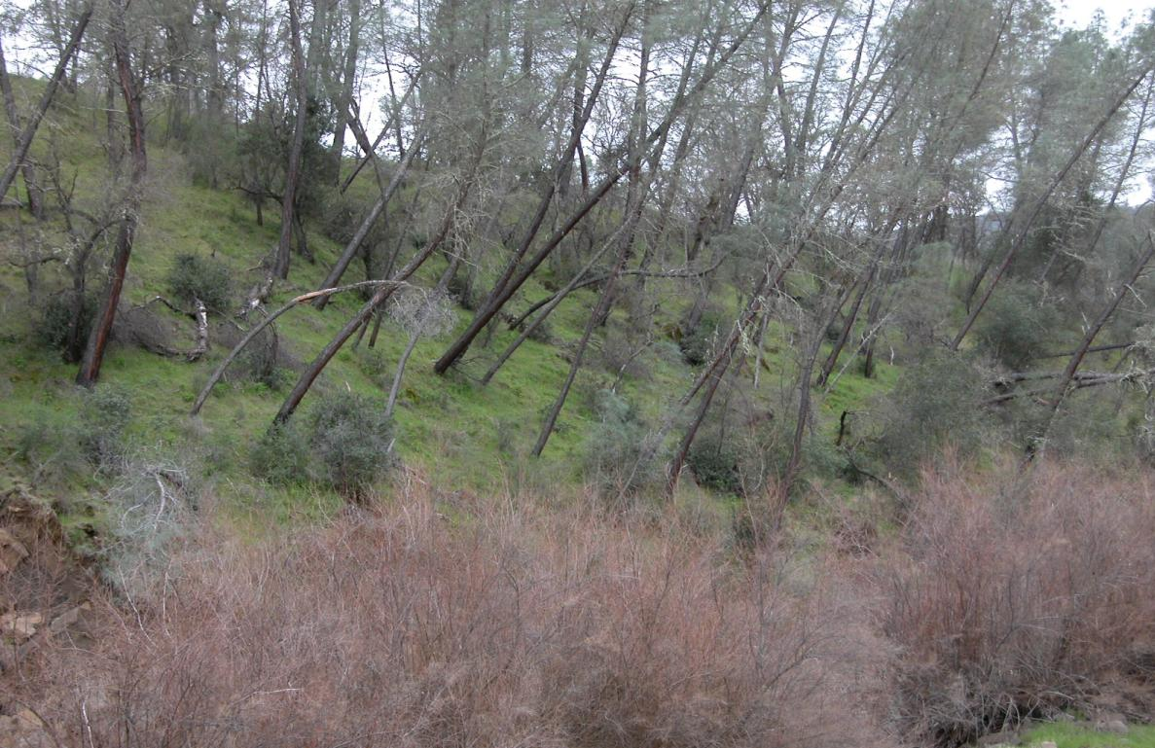
Tilted Trees

Slide 30

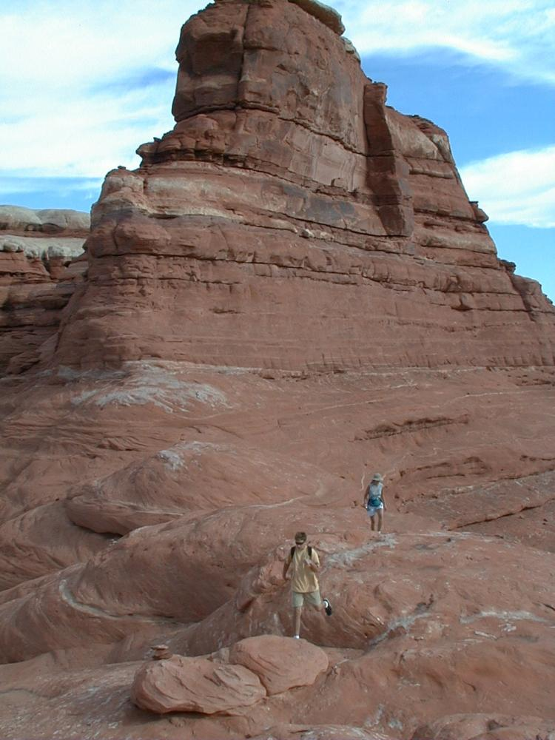
Land Capability: Soils Soils Range From Rock to Sand Trail Grade Depends on Use, Soil, and Season of Use
Notes:
Reconnaissance is also the time for careful assessment of land capabilities. Soil type and vegetation are clues as to whether or not the terrain is suitable for a trail. Best are durable soils on hillsides that can sustain a full bench with good outslope (more on these topics below). A varied matrix of good material, (eg, clay-sand, and angular gravel), will compact and keep soil moisture content, sustaining steeper grades and heavier use.

Slide 31
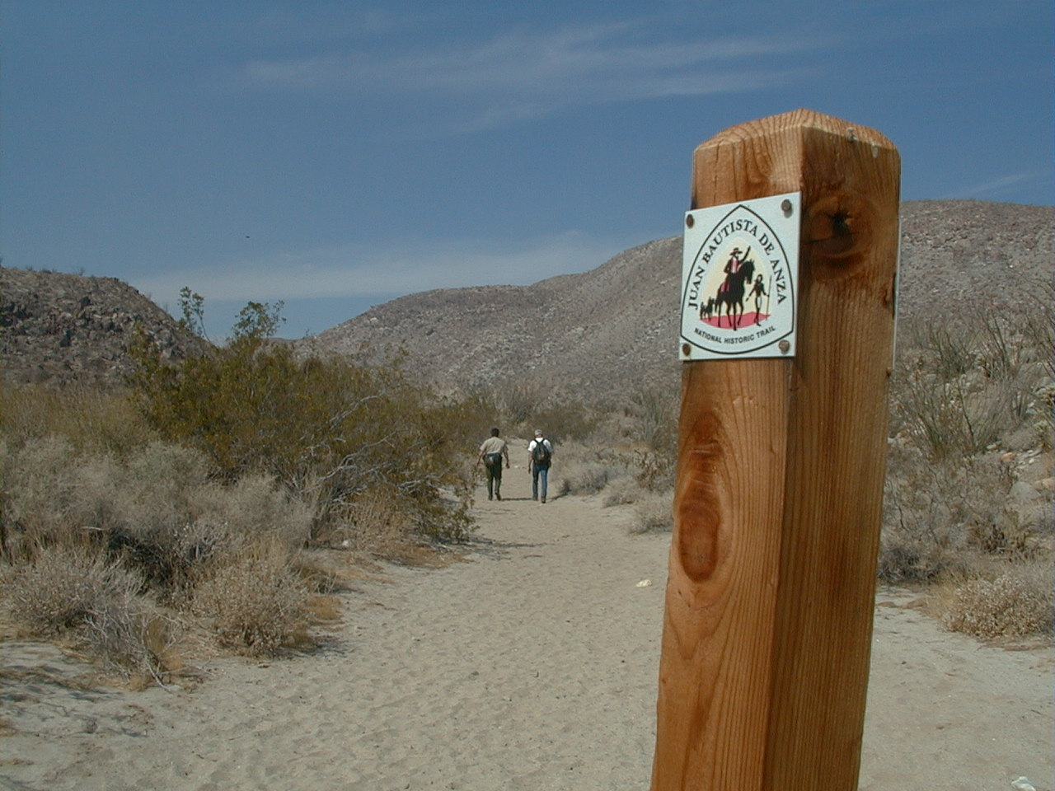
Sandy Soils Appear Stable
Notes:
And they might be stable, at flat grades.

Slide 32
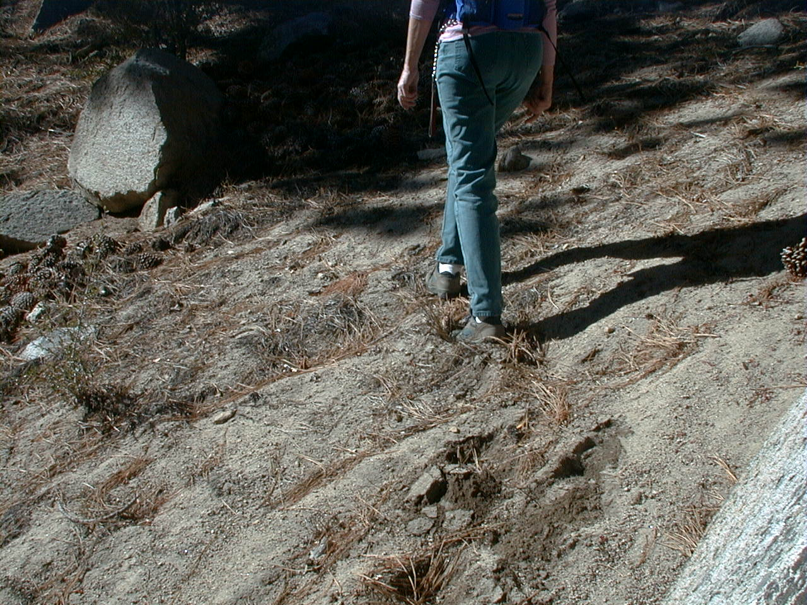
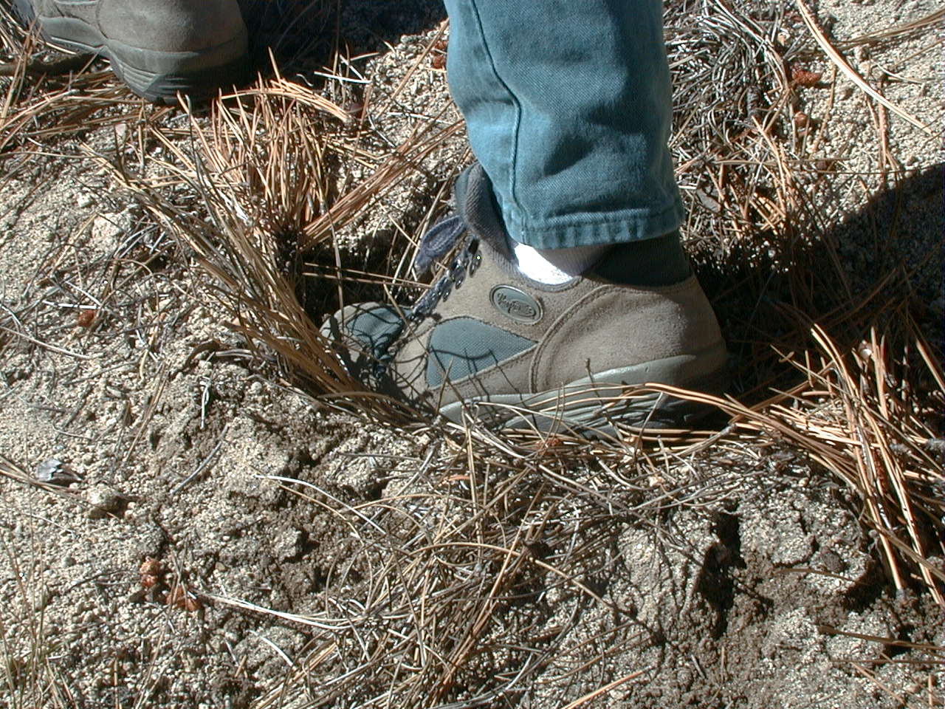
Sandy Soils Appear Stable
Until Slight Grades
Notes:
However, with even a slight grade change, soils that are primarily sand won’t hold up.

Slide 33
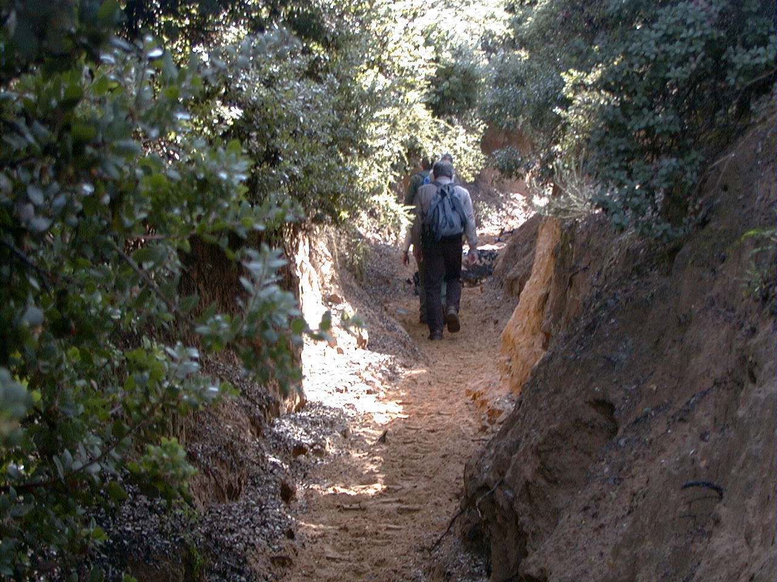
Notes:
Look at how much this sandy trail has gullied.

Slide 34
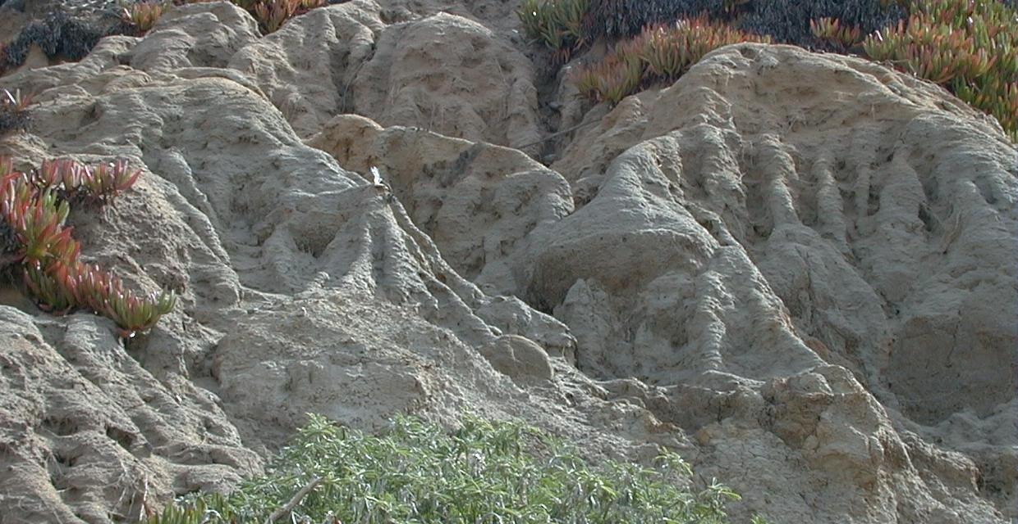
Clay Soils Lose Structure with Moisture
Notes:
“Pure” clay makes a good trail surface only when dry! However, some clay mixed in with other soil types, is a good thing.

Slide 35
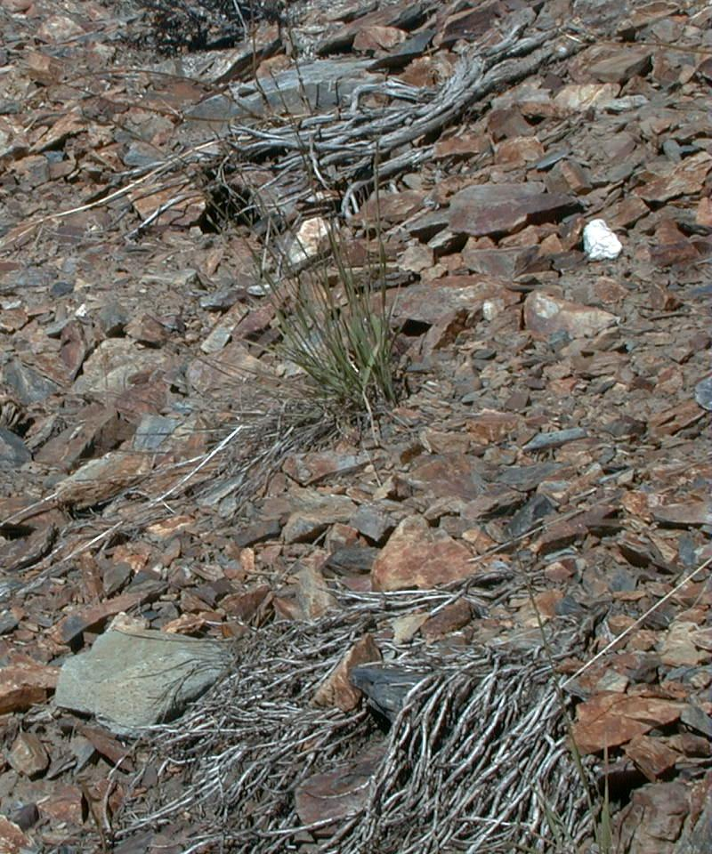
Angular Fractured Rock Shales Durable Material Matrix

Slide 36
From Least to Most Durable: (for trails with grade) Sand Silt Loam Clay Gravel Shale or Angular Rock
Notes:
Soils are almost never purely one of these, but a mix.

Slide 37
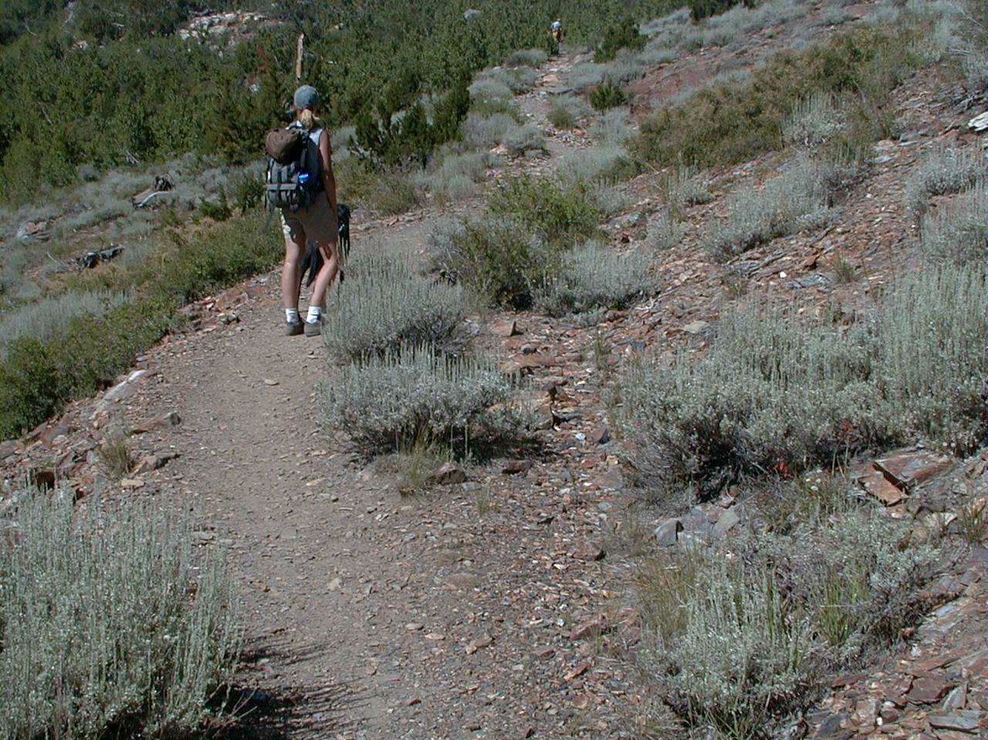
A Good Material Matrix Will Compact and Keep Soil Moisture Content Sustains Grade and Heavy Use
Notes:
A mix of soils with various particle sizes and a bit of fine binder material (eg, clay), produces a durable tread surface.
During reconnaissance, aim to align your corridor upon the most durable surfaces.

Slide 38
During Reconnaissance
Keep Track of Grades With Clinometer
Define a Rough Trail Corridor & Break it Into Smaller Segments
Notes:
After reconnaissance, designers plot a rough trail corridor, either on a map, with GPS, or on the ground with loose flagging.

Slide 39
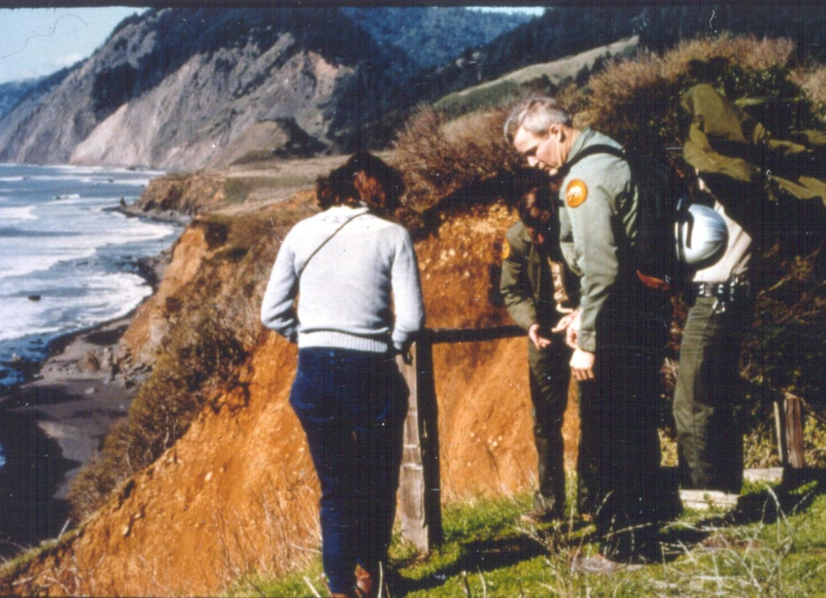
When Trail Corridor Is Narrowed Sufficiently
Get Resource Specialists Involved on the Ground
Notes:
Then it is time to call in resource specialists for their on-the-ground surveys. A trail that is to be built on any Federal land must follow guidelines of the National Environmental Policy Act (NEPA) to be sure that trail construction and use do minimal damage to fragile ecological, historical, or archeological resources.

Slide 40
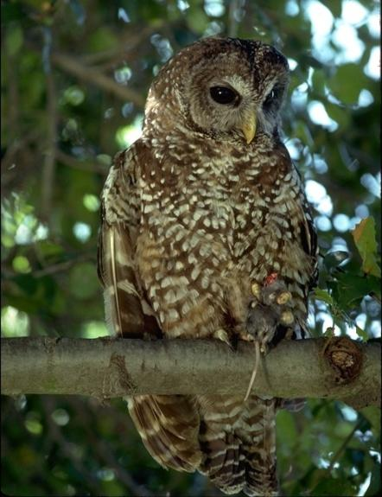

Consultation and Surveys on Sensitive, Threatened and Endangered Wildlife Species and Plants
Notes:
This involves the analysis by a variety of specialists, including botanists, wildlife and fisheries biologists, and archeologists, among others. If the specialists reveal sensitive areas that a trail could disrupt, designers then consider these major control points, and reassess the proposed route.

Slide 41
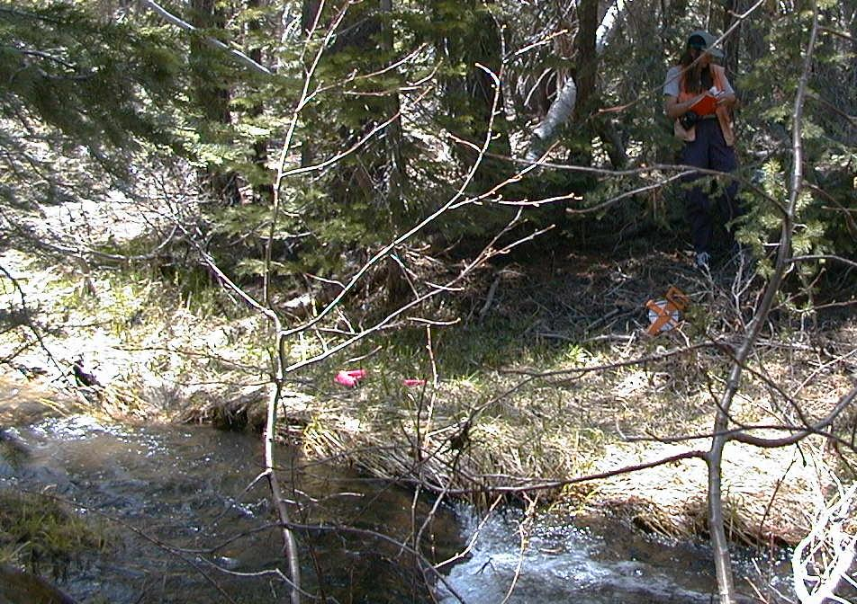
Hydrologist Review of Stream Crossings

Slide 42
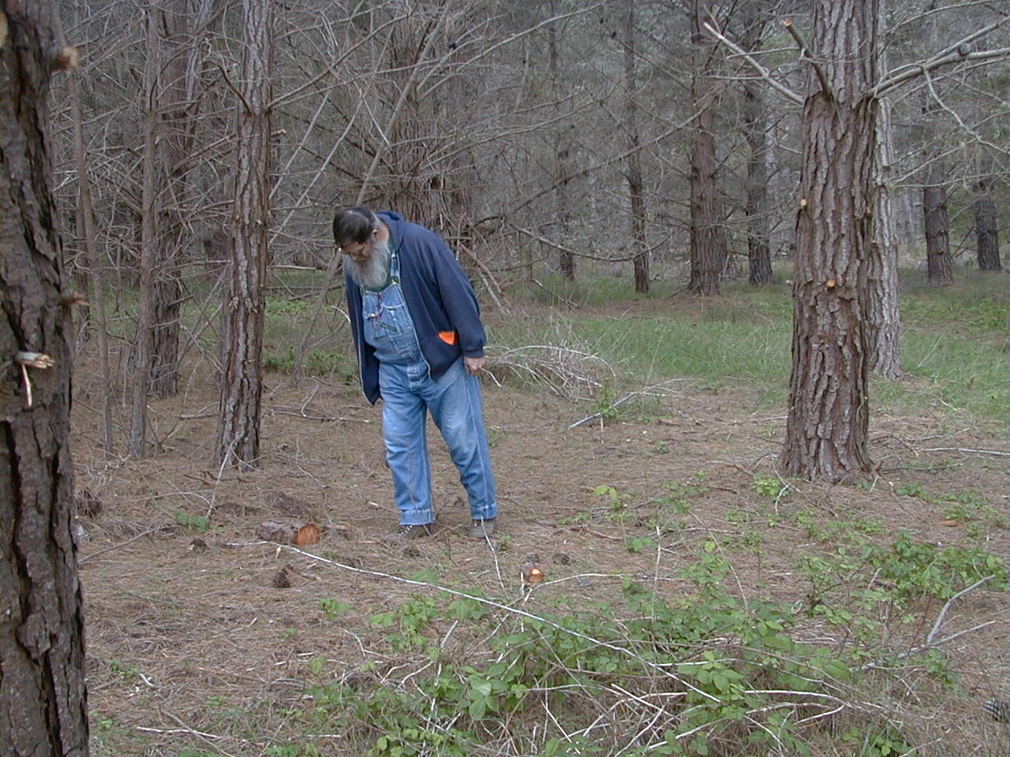
Archaeologist Cultural Survey

Slide 43
Trail Planning Process
Set User Type and Standards
Literature Search, Maps, Photos
Identify Major Control Points
Broad Corridor Proposal
Field Check by Reconnaissance
Negotiate Minor Control Points
Assess Soil Types and Land Capabilities
Rough Map Control Points and Trail Corridor
Bring In Resource Specialists for Review
Now Final Alignment Can Begin

Slide 44
Trail Layout

Slide 45
Trail Layout Concepts
Understand Hydrologic Influences of Trail Alignments
Determine the Maximum Sustainable Linear Grade
Measure Linear Grades Between Control Points
Learn the Process of Flagging the Trail Alignment

Slide 46
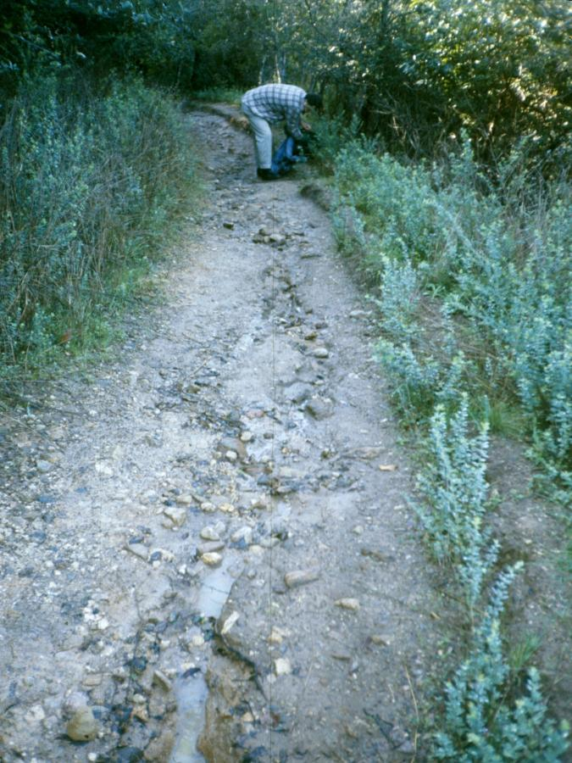
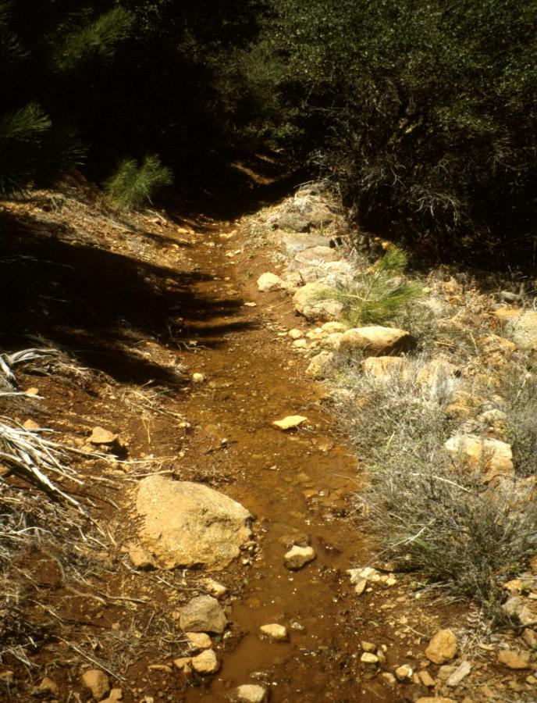
Water is the Most Influential Factor in Designing and Laying Out Trails
Notes:
What is happening on these trails? Water is flowing down the middle of the trail, causing erosion and disrupting the natural hydrological pattern of the hillside. This is what you do not want.

Slide 47
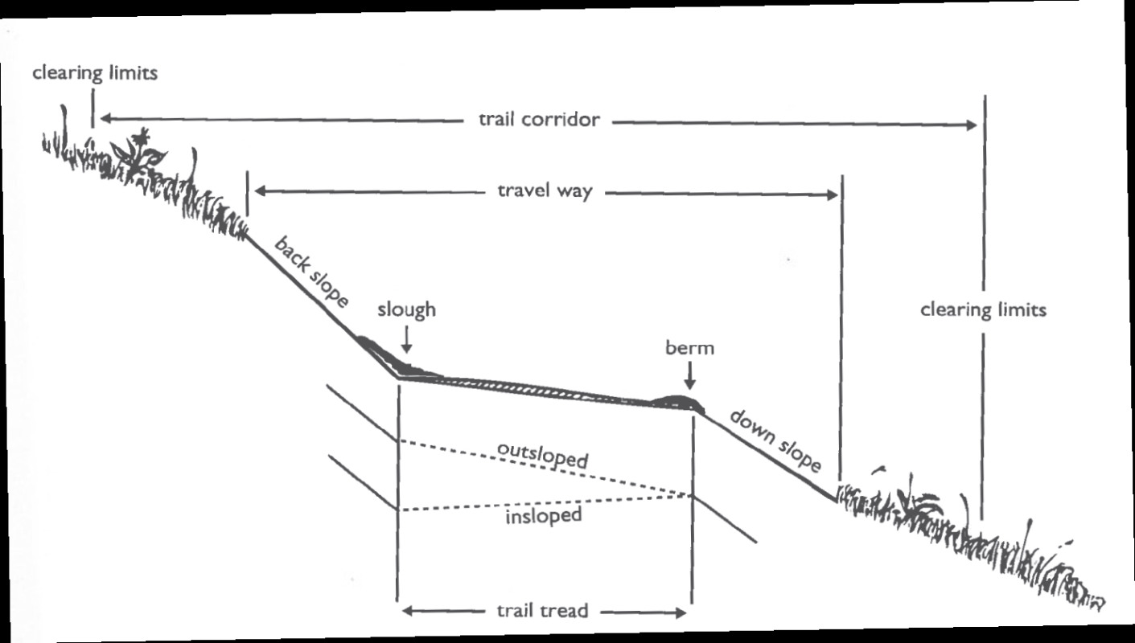
Trail Anatomy:
Sidehill Tread
Notes:
Ideal sidehill tread is outsloped, and has no slough or berm. In the last slide, if the berm were removed and the outslope restored, water would not have diverted onto the trail.

Slide 48

Curvilinear Alignment (Opposite of Fall Line) Makes the Trail Basically Perpendicular to Natural Sheet Runoff
Notes:
In a perfect trail world, water from rain, melting snow, and seeps, sheet flows down a hillside and encounters a trail with good outslope and no berm-- it gently crosses the trail and continues down the hillside without causing any erosion of the trail tread.
Water naturally goes down the fall line. The Fall line is the fastest way down the hill. If a trail goes straight up the fall line, there is no way to drain the water off of it.

Slide 49

Following the Contour of the Land Facilitates Natural Sheet Drainage Across the Trail
Notes:
Curvilinear alignment means following the contour lines, at gentle grades. A fall line trail, on the other hand, would intersect the contour lines.

Slide 50


Curvilinear Layout Requires Closely Following the Landform Pulling in and out of all Swales and Crenulations

Slide 51

Natural Runoff Patterns
Notes:
Runoff that begins as uniform sheetflow concentrates into naturally-formed drainages (aka draws, swales) which get bigger and bigger as they descend the hill.

Slide 52

Hillside Hydrology
Notes:
Same natural runoff pattern shown on a topo map.

Slide 53

Modified Runoff Pattern
Notes:
Now look what happens when we add a trail (yellow line). Water is diverted onto the trail. We’ve changed they hillside’s hydrological patterns. The small red lines indicate waterbars installed arbitrarily to drain the trail. This is not ideal. Notice what is happening below. Some areas (yellow circles) are drier than they used to be. Other areas (orange circles) are receiving too much water.

Slide 54
Interception and Diversion of Sheetflow
Notes:
Here is the same phenomenon on a topo map.

Slide 55


When Water Accumulates on the Trail and is Arbitrarily Drained Off It Creates Erosion Below the Drain Point
Notes:
What’s wrong with the placement of this waterbar? It drains onto a ridge.

Slide 56

Some Diversions Combine Two Drainages, Dewatering One and Destabilizing the Other

Slide 57

Vegetation and Wildlife Communities Below are Affected by Changing the Amount of Water They Receive
Notes:
We build trails to take us out into landscapes we want to enjoy in their natural state. But if our trails are changing the landscape’s hydrological patterns, we are impacting that landscape. Therefore, we need to ensure our trails are designed well and continue to drain properly– it is a Leave No Trace practice!
The best way to protect trails from typical erosion patterns is by good trail design and construction, whereby a new trail has curvilinear alignment and modest grades (less than 10-15%). Such a trail should pass only through durable soils on hillsides that can sustain a well-compacted full bench and generous outslope. This facilitates sheet flow and minimizes the need for drainage structures.

Slide 58

Curvilinear Layout Combined With Sidehill Construction and Outsloping Prevents Water Diversion and Accumulation

Slide 59

Following the Contours of the Land Alone is not Sufficient for a Sustainable Trail
Notes:
We need one more design concept to complete this picture of the ideal trail. Grade Reversals.

Slide 60


Grade Reversals Must be Designed in Natural Drainages to Prevent Water Diversion
Notes:
These pictures show how a water descending a natural drainage (aka draw, swale) can get diverted onto a trail. This could have been prevented with a grade reversal.

Slide 61

Notes:
The essence of the concept is that the trail should go uphill in both directions out of a natural drainage, no matter how dry or how small it seems.

Slide 62

Notes:
Despite the fact that this trail’s general trend is downhill at this point, it needs to climb uphill out of this drainage for just 10 feet or so, before continuing downward. That’s what we mean by reversing the grade temporarily.

Slide 63

Grade Reversals are Sometimes Incorporated Even in the Absence of a Natural Drainage Crossing
Notes:
Grade reversals are especially important wherever the trail passes through a natural drainage. However, as extra insurance, many designers incorporate frequent grade reversals even when the hillside is uniform, without apparent natural drainages. This is particularly pertinent under more erosive soil conditions, when the tread may not hold its outslope very well.

Slide 64

Frequency of Grade Reversals or Drains Depends upon Trail Grade and Soil Type
Notes:
Forest Service Trail Handbook chart suggesting spacing of grade reversals for specific soil types (because of their varying durability) for different trail grades.

Slide 65

When Possible, Align above big Trees to minimize Resource Impacts and Trail Structures

Slide 66

Retaining Walls are Usually Required When the Trail Passes Under a Large Tree
Notes:
Without a retaining wall, trail builders would be cutting into the tree’s roots.

Slide 67

Layout Trails on Hill Sides to Provide a Fuller Native Bench
Notes:
Hill sides are better for trails than flat areas.

Slide 68

Fuller Trail Benches Facilitate a Stable and Durable Trail Tread Surface

Slide 69


Full Bench
Part Bench
Notes:
Full bench construction means the entire tread surface rests on undisturbed native soil. Part bench means part of the tread surface is fill. Part bench is not recommended. The fill almost never becomes sturdy.

Slide 70

Trails on Gentle Side Slopes With Part Bench do not facilitate Sheet Runoff as Efficiently
Notes:
Trails can become difficult to drain when they are built on sideslopes of less than 15%. Only part-bench construction is possible when the sideslope is so gentle, and the sidecast material forms a berm that the water cannot surmount.

Slide 71

Retaining the Landform’s Natural Drainage Patterns Is the Key to Sustainable Trails

Slide 72
A Trail’s Tendency to Erode will be Influenced by many Factors. Consider these Factors in Order to Determine that Trail’s Maximum Sustainable Grade

Slide 73



User Groups

Slide 74

Source: Equestrian Trail Guidelines for Construction and Maintenance, published by the Conservation Commission of the State of Missouri
Notes:
Each user type exerts a different kind of pressure and a different kind of wear upon a tread surface. It is important that trails are built with the right surface material and grade to withstand the user type for which they are intended.

Slide 75

Level of Use
Notes:
Heavier use usually means more erosion, therefore you’d want a gentler grade.

Slide 76


Season of Use
Notes:
This trail can withstand summer traffic much more than winter. If it is meant for winter use, consider making the grade more gentle.

Slide 77


Soil Strength and Durability
Notes:
This sandy soil does fine at a relatively flat grade, but as soon as the grade gets a bit steeper, it erodes.

Slide 78



Annual Rainfall
Notes:
How much water falls on the hillside?

Slide 79

Rainfall Intensity
Notes:
Also in this category would be rapid snowmelt. If a trail needs to withstand a lot of water all at once, that will affect what you deem to be the maximum grade.

Slide 80



Canopy Cover
Notes:
Can protect a tread surface from some erosion.

Slide 81

Location on the Hillslope
Notes:
See how much rainfall the trail must withstand based on its location on the hillslope. Higher is drier.

Slide 82

Evaluate Existing Trails in the Area: Observe what Grade(s) are Sustainable
Notes:
If possible, a designer should assess similar trails in the nearby area and observe what grades are sustainable there.
Based on all these factors and observations, a designer should determine the maximum sustainable grade for the new trail.

Slide 83

Establish Prescribed Grade, then Compare to the Average Grade Between the Major Control Points
1,000 ft. elevation gain over 10,000 ft. of run
Notes:
After you’ve established the maximum sustainable grade, go back to your map and look at the average grade between major control points.

Slide 84
Rise ÷ Run = Grade Example: 1,000 Ft. Elevation Change ÷ 10,000 Ft. Linear Run = 10% Average Grade
Notes:
How to determine grade.

Slide 85


The Prescribed Linear Grade Is Used When Identifying Minor Control Points During Reconnaissance

Slide 86

Elevations can be Taken with an Altimeter at each Control Point to Determine Elevation Differences

Slide 87


Control Point Locations and Elevations are Plotted on a Topographic Map or GPS Unit

Slide 88

Avoid Blind Flagging: It Often Results in Abrupt Grade Adjustments
landslide
rock outcrop
steep slopes
spring
stream x
Notes:
For a given trail, while the overall target average grade may be 10%, the grade between any pair of control points is likely to vary. Make sure to work between two control points when ready to flag; otherwise, starting from the beginning and “blind flagging” at 10% will result in sudden grade adjustments as minor controls are encountered.

Slide 89
Layout is Performed Between Control Points to Eliminate Abrupt Grade Changes
10%
8%
7%
7%
9%
6%

Slide 90
Flagging From two Control Points Back Towards the Center is an Effective Method
10%
8%
7%
7%
9%
6%

Slide 91

160’ elevation / 2,000’ of run = 8%
9%
10%
9%
6%
7%
8%
Notes:
The average grade is 8%, but, some of the segments between control points are 10%. What to do if the maximum sustainable is 8%?

Slide 92

If the Average Linear Grade Exceeds the Prescribed Grade Additional Linear Run may be Required
Notes:
If the grade between two points exceeds maximum, a designer needs to add run (distance) with well-placed turns. Topographical turns are preferable to switchbacks or climbing turns, because they are less detectable, and therefore less prone to cutting.

Slide 93
To Gain Additional Linear Run a Topographical Turn Should be Used First
Notes:
If switchbacks or climbing turns are necessary, each one should be located very deliberately. Locate to facilitate drainage away from the corner by using a ridge nose or a natural topographical swale/drainage.

Slide 94


Slide 95


Slide 96


If a Topographic Turn Is Not Available Then a Climbing Turn or Switchback Can Be Used to Gain Linear Run
<30%
>30%

Slide 97


Climbing Turns and Switchbacks Need to Be Properly Placed
A Good Place for a Turn then becomes a Control Point
Notes:
If switchbacks or climbing turns are necessary, each one should be located very deliberately. Ideal spots for turns are not easy to come by. Therefore, when a designer finds a good spot for a turn, that becomes a control point and influences trail alignment.

Slide 98

Locate to Facilitate Drainage away from the Corner or Turn

Slide 99
Use a Ridge Nose or a Swale/Drainage
Notes:
Locate to facilitate drainage away from the corner by using a ridge nose or a natural topographical swale/drainage.

Slide 100

There Must Be Good Separation Between the Two Legs to Prevent Cutting

Slide 101


Utilize Trees, Rocks and Brush to Provide a Barrier Between the Two Legs. Proper Location will help Reduce Linear Grades

Slide 102


Incorporating Vistas into Switchback Corners will Help Prevent Cutting

Slide 103


When Using Multiple Switchbacks Maximize the Distance Between Each Switchback to Eliminate “Stacking”

Slide 104


Notes:
What is done right in this switchback? Drainage, topographical bump and imported log provide barrier and separation between the two legs

Slide 105
Common Design Mistakes
Notes:
Students will recognize common design mistakes evident in many existing trails. Inadequate planning can result in the need later to realign sections at steep grades, or to decommission trails that erode too easily.

Slide 106

Laying Out Trails on Top of Ridges Should Be Avoided
Notes:
Traditionally, many trails were located on broad ridge tops, where views are great, but opportunities to drain the tread are scant. The problem with ridgeline trails is one species of the problem with fall line trails.

Slide 107

Notes:
See how much soil this ridgetop trail has lost. It is very difficult to drain this trail in its present location.

Slide 108

Notes:
An extreme case of ridgetop trail erosion.

Slide 109
Place Trails on the Side of the Ridge and Cross Over at Saddles to Provide Alternate Views
Notes:
Better to locate trails on a hillside, and cross over the ridgeline at a saddle to provide views in the other direction.

Slide 110

Crossing Over at a Saddle

Slide 111


Flat Poorly Drained Land Should be Avoided
Notes:
Flat areas and meadows, too, have historically been popular places to locate trails. However, these locations too are destined for drainage problems.

Slide 112

Notes:
On a flat creekside, the trail intercepts the hillside’s water before it can reach the creek.

Slide 113


Notes:
With any amount of compaction, a trail across a flat area becomes the lowest place on the landscape.

Slide 114


Meadows and Open Prairies Should Be Avoided. Trail Alignments Should Skirt the Edges If Possible.
Notes:
A trail cutting across a meadow can really change its hydrological patterns. It can even lower the water table and affect what kind of vegetation can survive there.

Slide 115
Trail Flagging

Slide 116

Prior to Flagging, Establish Horizontal Reference Points (“Zero”) on a Partner Using a Clinometer
Notes:
After these slides are over, students should pair up with someone about their same height, and find Zero on that person while standing on flat ground.

Slide 117

Sometimes there is too much height difference to establish a reliable reference point

Slide 118

Notes:
You can also use stakes with flags tied at the “Zero” reference point.

Slide 119

With a Two Person Team The Shooter takes the Front Position so the Shooter Can See the Upcoming Terrain

Slide 120

The Shooter Walks to a Location at the Approximate Prescribed Grade Staying on Contour

Slide 121

The Shooter Locates Their Reference Point on their Partner and Moves up or Down Slope to the Prescribed Grade

Slide 122

The Shooter Then Places a Flag Marking Trail Grade

Slide 123

The Shooter Moves Forward for the Next Shot and the Partner Moves to Where the Shooter Previously Stood

Slide 124

Be Careful Not to Shoot Across Topographic Features
Notes:
When using a clinometer on variable terrain, be careful not to shoot across big bumps or depressions, as this will distort results.

Slide 125


Slide 126

When Flagging in and out of a Stream, the Downhill Leg Needs to Level off or Climb for a Short Distance
Notes:
Who remembers what this is called? A grade reversal.

Slide 127




The Initial Flag Line Should Be Loose Flagged. Tight Flagging Is Performed Once the Loose Flagging Is Completed

Slide 128


Finally, Make Note of any Special Trail Structures Needed

Slide 129

Identify Potential Sources for Native Construction Materials
Notes:
The end. Now you are ready for the trail construction crew!

Slide 130
Trail Layout Process
Identify user types and design standards
Reconnaissance to evaluate the landform and soil
Observe hillside hydrological patterns
Determine maximum sustainable grade
Identify control points
Assess linear grades between controls
Incorporate well-placed turns if needed to decrease grade
Flag between control points
Develop plans for any trail structures
Notes:
Review the Layout Process

Slide 131

200. Basic Trail Design

